Slide 1
Resting

Slide 2
Today our focus is on resting. We pick up the story after Jesus has died on the cross.
Before we start, consider these questions…
How do you feel the day AFTER a big occasion, like your birthday or Christmas day?
How do you feel after something has gone terribly wrong?

Slide 3
Luke’s gospel tells this part of the story
Luke - Chapter 23
⁵⁰⁻⁵¹ A man from the Jewish town of Arimathea was there, too. His name was Joseph. He was a good, religious man. He wanted the kingdom of God to come. Joseph was a member of the Jewish council, but he had not agreed when the other leaders decided to kill Jesus. ⁵² Joseph went to Pilate to ask for the body of Jesus. ⁵³ So Joseph took the body down from the cross and wrapped it in cloth. Then he put Jesus’ body in a tomb that was cut in a wall of rock. This tomb had never been used before. ⁵⁴ This was late on Preparation Day. When the sun went down, the Sabbath day would begin.
⁵⁵ The women who had come from Galilee with Jesus followed Joseph. They saw the tomb and saw inside where the body of Jesus was laid. ⁵⁶ Then the women left to prepare perfumes and spices.
On the Sabbath day they rested, as the law of Moses commanded.

Slide 4
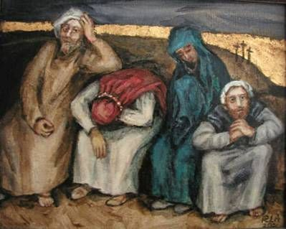
The next day after Jesus’ death was the Sabbath, the holy rest day, when nobody worked.
Look at this picture of the friends of Jesus after his death.
How do they look?
What do you think they are feeling?
Remember, they had no idea what amazing thing was about to happen!

Slide 5
The friends of Jesus were distraught about what had happened and anxious about what lay ahead. Sometimes, when we can’t see the future, we exhaust ourselves worrying about what will come.
Christians believe that waiting does not have to mean worrying, even if we don’t know what lies ahead. They trust that God is in charge and is looking after them, whatever happens.
Worrying doesn’t change the future. We can all learn to wait without worrying. This helps us rest and keeps our batteries topped up. As a result it is good for our health and wellbeing. Waiting restfully like this might not solve our problems, but it does help us to cope better with those times that are more difficult.

Slide 6
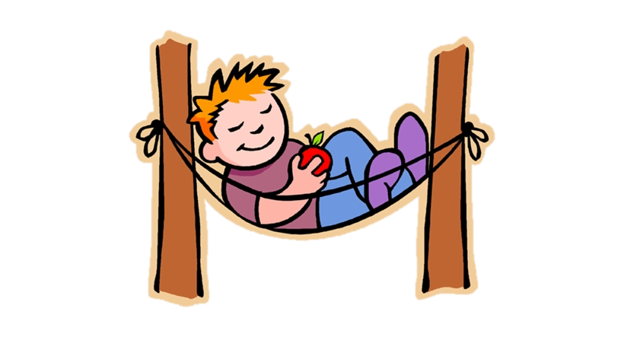
Putting resting into action!
You might like to try…
Put a worry aside. You might want to talk to someone about it or to write it down and put it somewhere safe. Use this to step away from that worry, as worrying doesn’t change anything.
or
Speak to your family about when they rest and encourage them to keep a rest diary for a week. You can look back at it after seven days and discuss how you rest and if you are all resting enough.

Slide 7
Father God, thank you for being with me through good times and bad. Today, help me not to worry but to slow down and find rest. Please guide me when I do, so that I may know your presence and your peace. Amen

Slide 8
This resource was produced by the Diocese of Leeds Education Team. For more information about this or future resources,
please contact your named adviser:
simone.bennett@leeds.anglican.org
simon.sloan@leeds.anglican.org
darren.dudman@leeds.anglican.org
janet.tringham@leeds.anglican.org
lee.talbot@leeds.anglican.org
rupert.madeley@leeds.anglican.org

