Slide 1
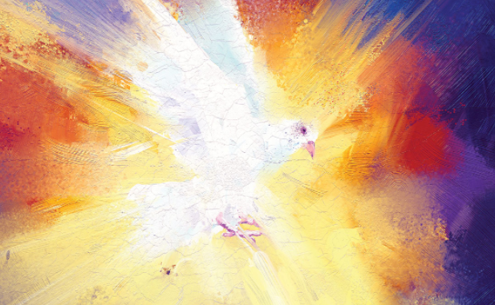
The Rhythm of Life
Pentecost

Slide 2
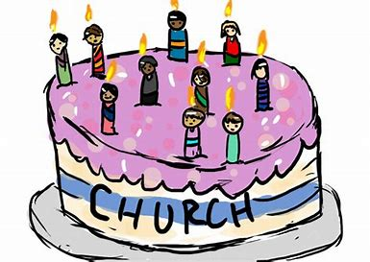
Pentecost
Pentecost is known by Christians as the ‘Birthday of the Church’. Today we will think about what it is, why it is celebrated and how it relates to the Rhythm of Life habits.
Before we start, consider these questions:
What does it feel like when you are trying to do a really difficult task all on your own?
How does doing something with someone you trust make it easier?

Slide 3
Previously we looked at the Easter story, when Jesus died on the cross and then rose again from the dead on the first Easter Sunday. The Bible says that after 40 days, having appeared to the disciples and others many times, Jesus went back into heaven.
The followers of Jesus had got very used to having him around, both when he was alive and after the Resurrection. Now they were on their own again, with a huge task to complete.
How would they be able to spread the good news of Jesus without him there to lead them?

Slide 4
But Jesus had prepared them for this. Before he died he told them:
John - Chapter 14
¹⁶ I will ask the Father, and he will give you another Helper. He will give you this Helper to be with you forever…. ²⁵ I have told you all these things while I am with you. ²⁶ But the Helper will teach you everything. He will cause you to remember all the things I told you. This Helper is the Holy Spirit whom the Father will send in my name.

Slide 5
A few days after Jesus had gone back to heaven, his followers were meeting together. Listen to what the Bible says happened next.
Acts - Chapter 2
¹ When the day of Pentecost came, they were all together in one place. ² Suddenly a noise came from heaven. It sounded like a strong wind blowing. This noise filled the whole house where they were sitting. ³ They saw something that looked like flames of fire. The flames were separated and stood over each person there. ⁴ They were all filled with the Holy Spirit, and they began to speak different languages. The Holy Spirit was giving them the power to speak these languages.

Slide 6
After Pentecost, the followers of Jesus had new confidence and strength to spread the message of Jesus right across the known world. They believed that God, in the form of the Holy Spirit, was with them wherever they went, guiding and helping them.
Even when things got very difficult for them, and people began to persecute and kill them for their faith, they were able to stand strong and to keep following and serving Jesus.
Because of the way these first Christians lived and spread the message of Jesus, there are Christians today following God in every corner of the globe!

Slide 7
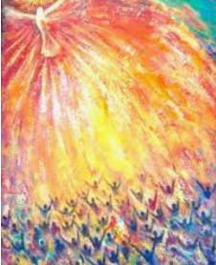
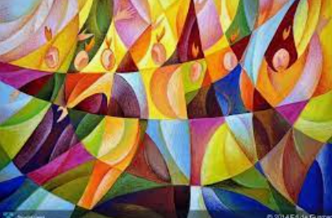
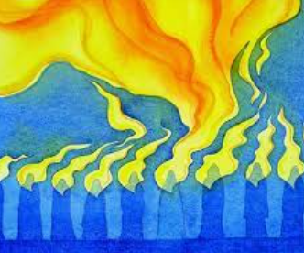
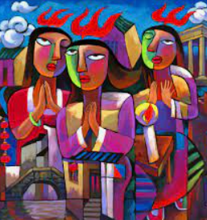
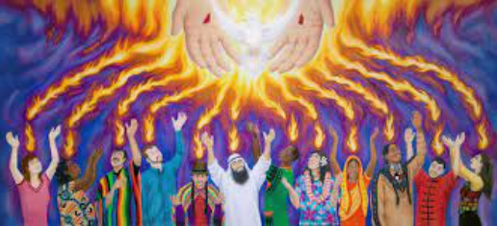
What a strange event Pentecost must have been!
Which of these artists’ impressions of this event do you like and why?

Slide 8
For Christians, the fire and wind are symbols of God’s presence. Every year Christians celebrate Pentecost because they believe that this was when God came to live with each Christian, giving them the power to live as God would want them to and to serve him.
Previously in Rhythm of Life, we have looked at 7 habits - Celebrating, Praying, Resting, Creating, Reflecting, Encouraging and Sharing - that help us live good lives. Following Pentecost, we will look at the lives of some people who have lived out these habits. They will be examples of how Christians believe humans can live, empowered by the Holy Spirit, as God would want us to.
As we think about that first Pentecost, what gives you the strength each day to do the right thing and live the right way?

Slide 9
You might like to:
Help someone today who is finding something hard. Your help and encouragement can enable them achieve what they might not be able to on their own.
or
Draw or paint a picture of the scene at Pentecost, like the ones we looked at. Be creative and exciting, showing the tongues of fire and the roaring wind! As we have seen, sometime an abstract painting is the best way to captures such an amazing event.

Slide 10
If you would like to, you can join in saying these prayers.
A Prayer for the Day
The Rhythm of Life Prayer
Holy Spirit,
Thank you for coming in power on that first Pentecost.
Thank you that you are happy to live in us, guiding us and giving us the strength to live our lives for God.
Amen
Loving God,
as we journey through life,
help us to practice these habits
so that the rhythm of our lives
can bring us closer to each other
and to you.
Amen

Slide 11
The Rhythm of Life
Pentecost
simone.bennett@leeds.anglican.org
simon.sloan@leeds.anglican.org
darren.dudman@leeds.anglican.org
janet.tringham@leeds.anglican.org
lee.talbot@leeds.anglican.org
rupert.madeley@leeds.anglican.org
This resource was produced by the Diocese of Leeds Education Team.
For more information about this or future resources, please contact your named adviser:

