Slide 1
The Rhythm of Life Advent Journey
Encouragement

Slide 2
Have a think about this verse from the Bible…
“So speak encouraging words to one another. Build up hope so you'll all be together in this, no one left out, no one left behind.”
I Thessalonians 5:11a (The Message)
Can you think of ways you already do this at school and at home?
What do you think this verse means?

Slide 3
Here is a short video for you to watch.
As you do, think about how Clint felt at different times?

Slide 4
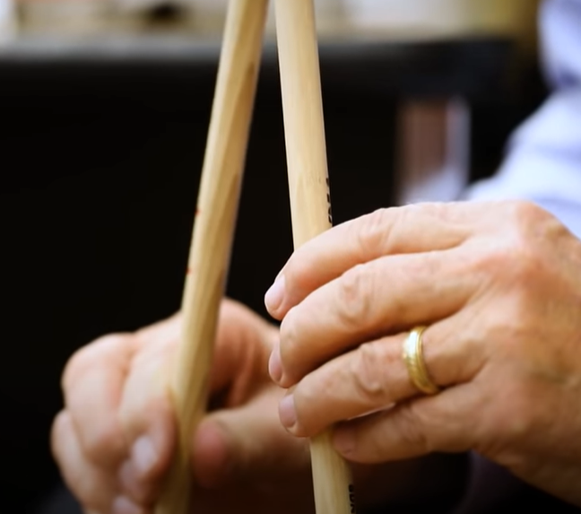
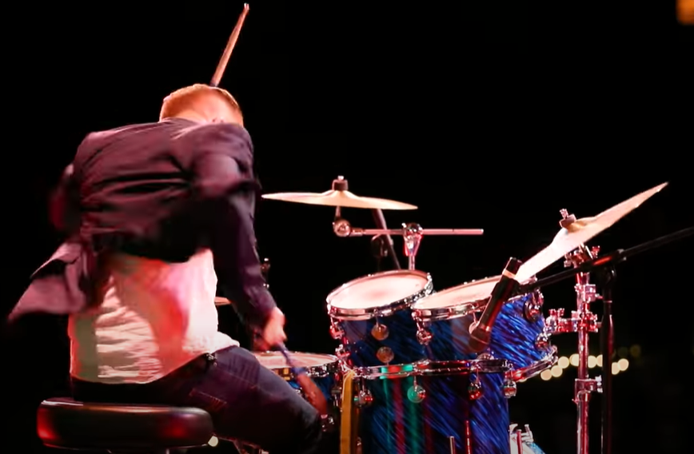
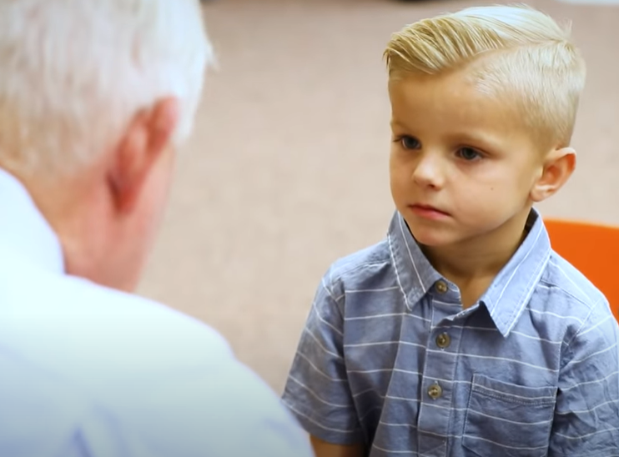
What did you think?
What might have happened if Mr Jenson hadn’t been there to encourage him?
What did Mr Jenson do to make a difference?
How did Clint feel at different times during the video?

Slide 5
A thought to take away…
The dictionary says that encouragement is words or behaviour that give someone confidence to do something or make something more likely to happen.
Sometimes it can be a single word, a smile, remembering a birthday or just being there for a friend. We can all encourage others and others have the power to encourage us.
Today, how can you encourage someone in your class? At home?

Slide 6
Today’s Challenge
If you would like to join in with today’s challenge, why don’t you:
Send a message or card to someone to tell them all the things you love about them…you can also do this to yourself as well.
or
See what you can find out about a character in the Bible called Barnabas. His name means ‘son of encouragement’. Do his actions match his name?

Slide 7
Celebration 1
If you would like to, you can join in saying these prayers.
A Prayer for the Day
The Rhythm of Life Prayer
Dear God,
Thankyou for those that encourage us and help us to be the best we can be.
Help me to use my words and actions today to be someone who encourages others.
Amen
Loving God,
Help me to learn from you
the habit of encouraging,
so that the rhythm of my life
can match
the rhythm of your heart of love.
Amen

Slide 8
This resource was produced by the Diocese of Leeds Education Team.
For more information about this or future resources,
please contact your named adviser:
simone.bennett@leeds.anglican.org
simon.sloan@leeds.anglican.org
darren.dudman@leeds.anglican.org
janet.tringham@leeds.anglican.org
lee.talbot@leeds.anglican.org
rupert.madeley@leeds.anglican.org

