Slide 1
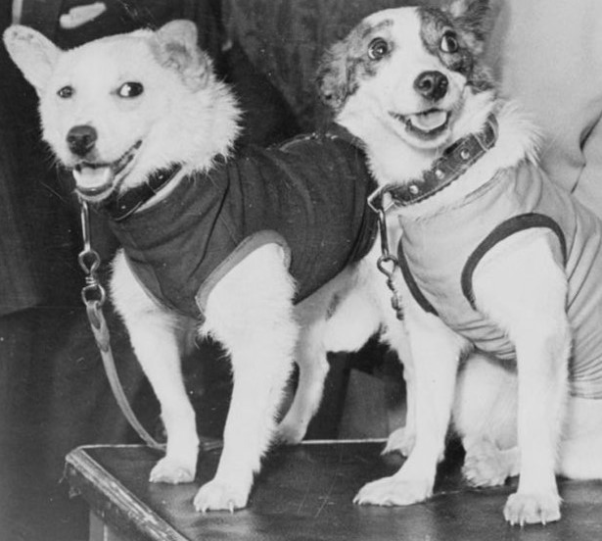
Changes within Living Memory Space travel
KS1 Topic: Changes in Living Memory Block C: Transport Session 7, 8 and 9
Lift-off into space!
Fruit-flies, mice, dogs and monkeys were all sent into space in rockets between 1947 and 1951.
Many did not return safely. The first animals to return safely to earth were Tsygan and Dezik in 1951.
© Original resource copyright Hamilton Trust, who give permission for it to be adapted as wished by individual users.
We refer you to our warning, at the foot of the block overview, about links to other websites.

Slide 2
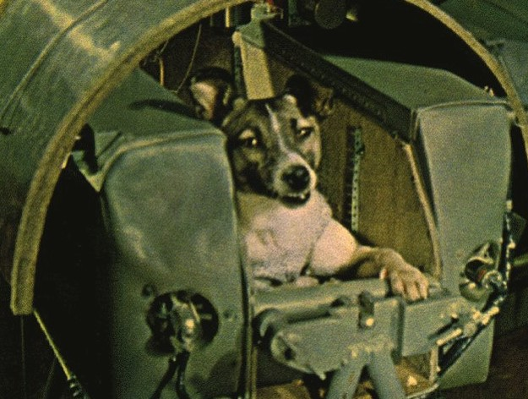
Changes within Living Memory Space travel
Lift-off into space!
Laika – the first animal to orbit the earth, in 1957.

Slide 3
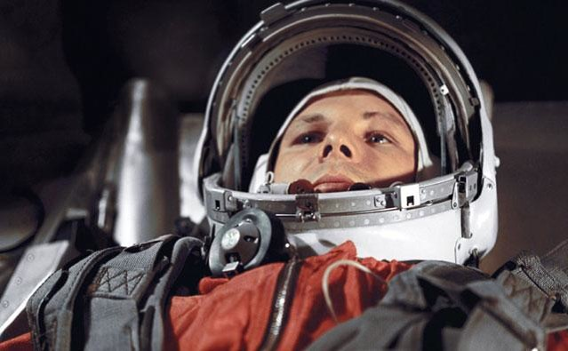
Changes within Living Memory Space travel
Lift-off into space!
Yuri Gagarin the 1st person to orbit the earth in 1961 in a Russian spaceship.
Watch this video documentary (see note in session 7 plan before showing to class)
http://www.youtube.com/watch?v=qQMZ-emCG-M

Slide 4
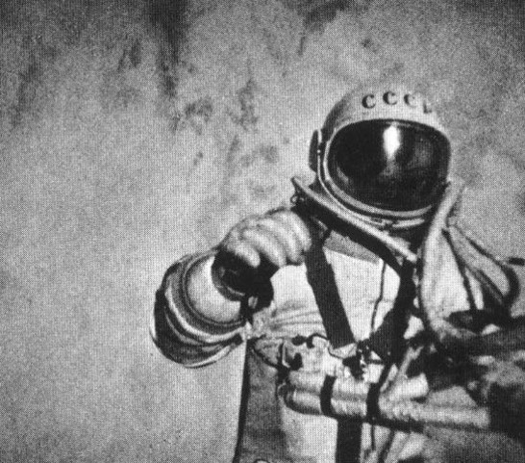
Changes within Living Memory Space travel
Lift-off into space!
This photograph was taken from an external camera on his space ship Voskhov 2. It was a Russian mission.
Aleksey Leonov was the first person ever to walk in space 1965.

Slide 5
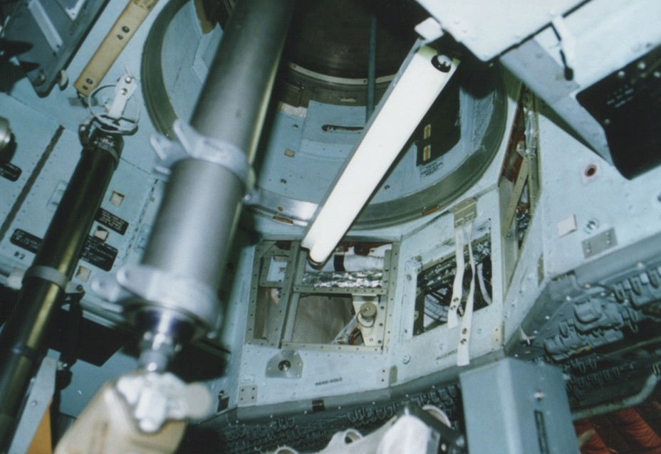
Changes within Living Memory Space travel
Lift-off into space!
Here is the inside of an Apollo rocket.

Slide 6
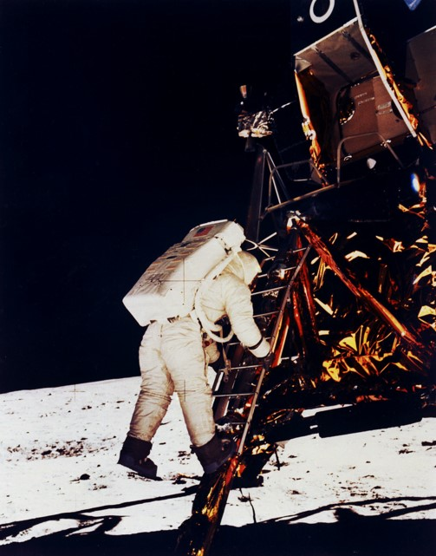
Changes within Living Memory Space travel
Moon landing
The first ever spaceship to land on the moon was Apollo 11.
Three men climbed down the ladder to the moon’s surface.
They planted a flag and a plaque.
Here men from the planet Earth first set foot upon the moon. July 1969 A.D. We came in peace for all mankind
Watch this video documentary
http://www.nasa.gov/mission_pages/apollo/apollo11.html#.VEI1Rf0u-lI

Slide 7
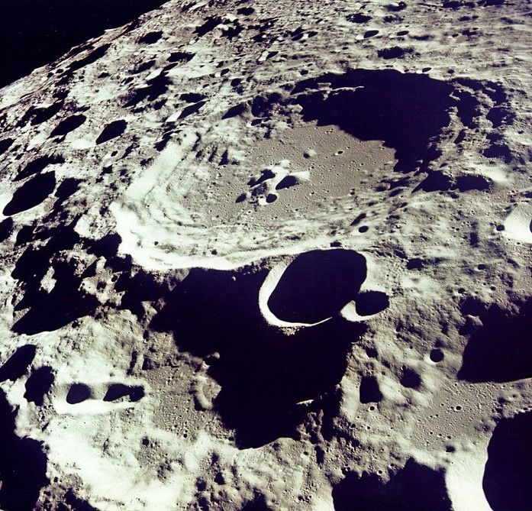
Changes within Living Memory Space travel
Moon landing
This is a photograph taken on the first moon landing.
It is crater 308, part of an area of the moon called ‘The Sea of Tranquility’.
Watch the actual moon walk here.
http://www.youtube.com/watch?v=RMINSD7MmT4

Slide 8
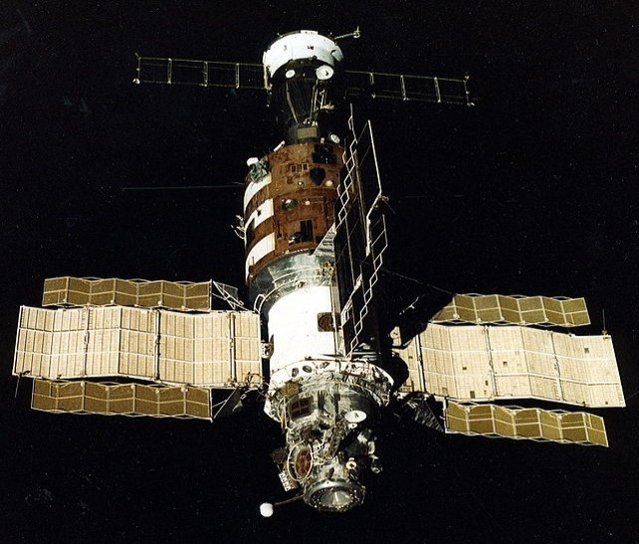
Changes within Living Memory Space travel
Space stations
Salyut 1 was the 1st ever Space Station.
It was launched by the Russians in 1971.
The first crew stayed on board for 23 days.
Salyut 1 lasted 175 days, nearly 6 months.
Since Salyut 1 space stations have improved greatly and now they are international.

Slide 9
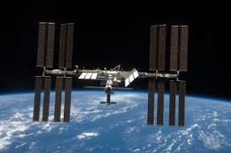
Changes within Living Memory Space travel
Space stations
This is the International Space Station.
Astronauts live up in the space station for up to one year.
They come from different countries.
Take an actual tour of the International Space Station
http://www.nasa.gov/mission_pages/station/main/suni_iss_tour.html

Slide 10
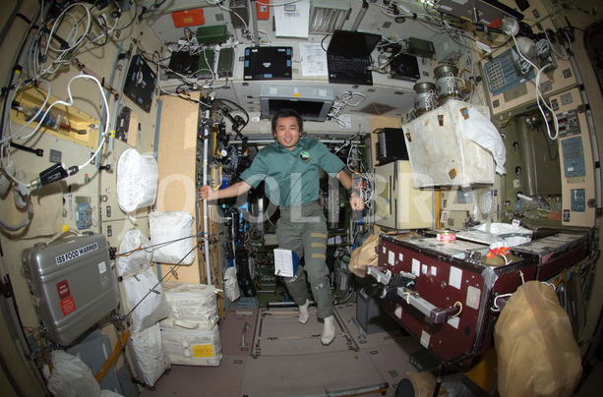
Changes within Living Memory Space travel
Space stations
The interior of the International Space Station

Slide 11
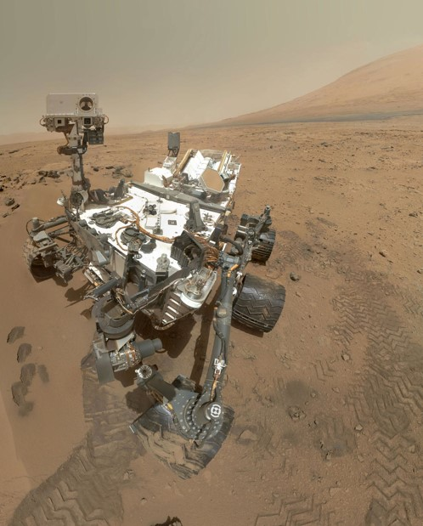
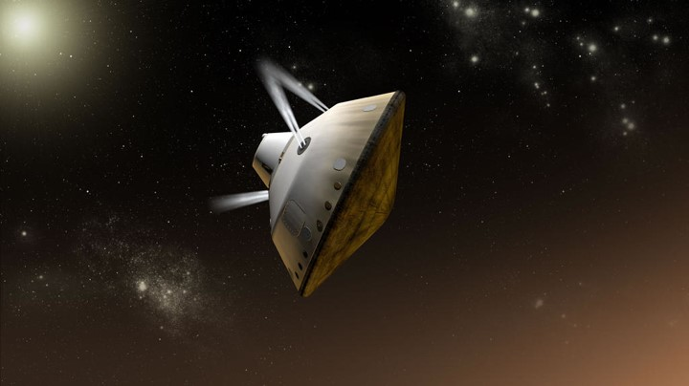
Changes within Living Memory Space travel
Going to Mars!
Here is the space laboratory that was dropped onto Mars in 2004.
It carried ‘Curiosity’ – a special Mars rover.
Look at some of the pictures taken by Curiosity.
http://mars.nasa.gov/msl/multimedia/images/

Slide 12
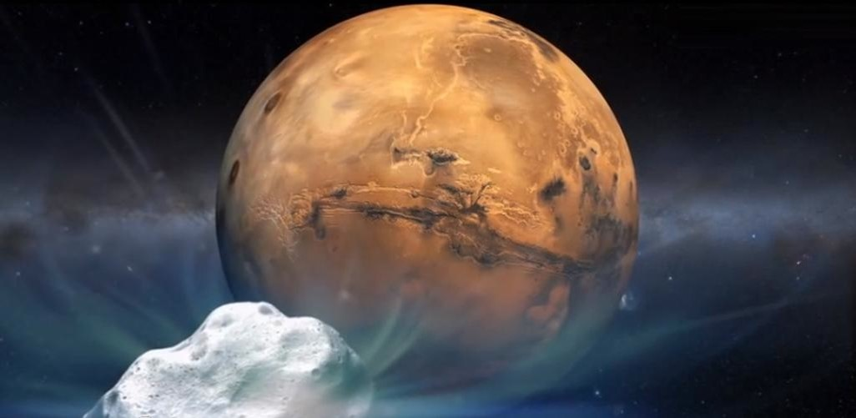
Changes within Living Memory Space travel
Going to Mars!
See some more images of mars on NASA’s website.
http://mars.nasa.gov/msl/

