Slide 1
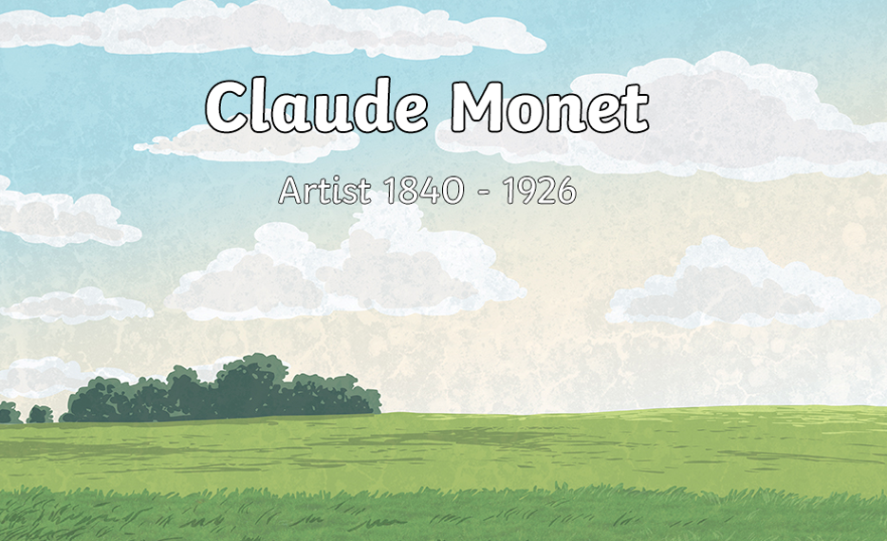
Our Art unit is all about the famous artist Claude Monet.

Slide 2
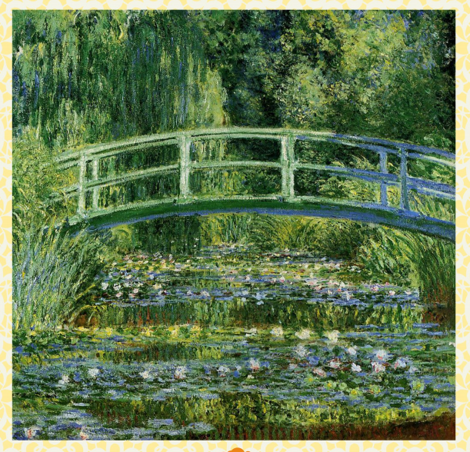
Title - Water lilies
This is one of Monet's paintings

Slide 3
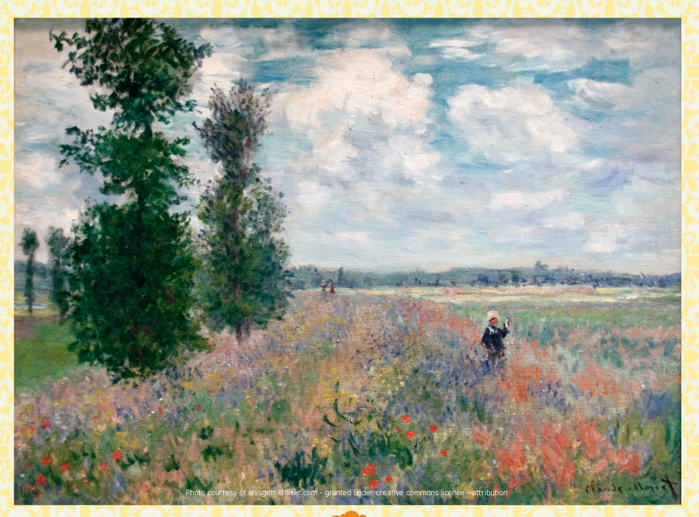
This is one of Monet's paintings

Slide 4
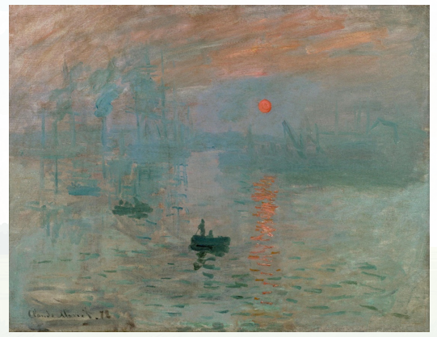
This is one of Monet's paintings
Title - Impression, sunrise

Slide 5
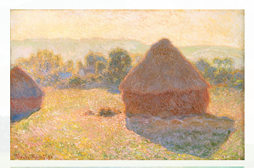
This is one of Monet's paintings
Title - Haystacks

Slide 6
What do you notice about these paintings?

Slide 7
Thoughts...
They are all painted from exactly the same spot – Monet loved to paint the same scene again and again.
They are all quite hazy or blurred – Monet liked to paint in a fast style that gave a quick impression of a scene rather than lots of detail
-He has painted the water and the sky in the same colours – Monet loved the way the light in the sky was reflected in the water
-There are lots of pinks and oranges in the paintings – Monet loved to paint at sunrise and sunset when the light was low and the colours were warm, he also liked to paint the mist and fog over the river and in those days (he painted these pictures between 1902 and 1905) there was a lot of air pollution from factory smoke that mixed with the fog to form “smog.”

Slide 8
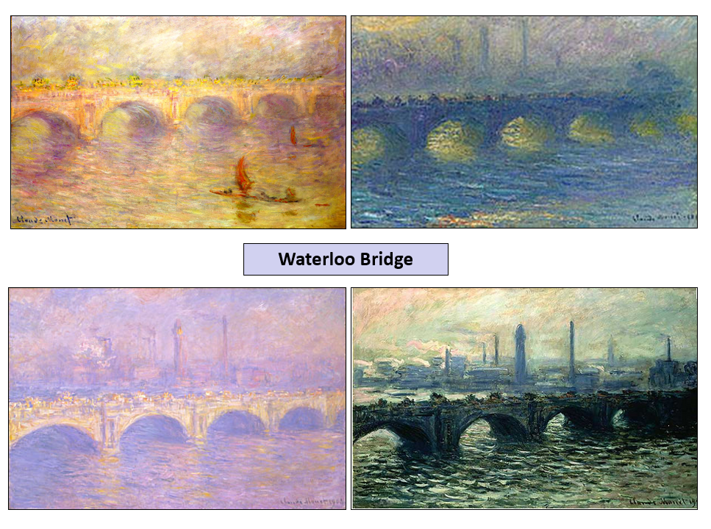
Here are more of Monet's paintings... again all painting the same view.

Slide 9
Monet made a large number of paintings of Waterloo Bridge too: again they were all painted from exactly the same spot.
Although he has painted the same bridge from the same place, are the paintings the same?
No they're not.
How are they different?
The colours and the way the light is shining.
What impression does each picture give?
Think about the time of day, the weather, and the mood.
Monet loved to capture a mood or impression in his work.

Slide 10
You are now going to try and create your own version of Monet's Palace of Westminster.
Go to the next slide for instructions.
Remember, that the instructions are for you to use acrylic paint, but you can use anything that you have.

Slide 13
Well done - you have completed the lesson.
Think about what has worked well? What was difficult about the task?
Thinking about this well as it will help you with next week's lesson.
It would be great if you could send me a photo of your painting – I’d love to see it.

