Slide 1
The Rhythm of Life Advent Journey
Praying

Slide 2
Celebration 1
A question to get you started.
Why do you think people pray?

Slide 3
Celebration 1
Have a thoughtful look at these images.
What might they teach us about prayer?
What questions would you ask the people
in the pictures?

Slide 4
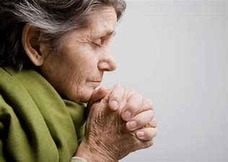
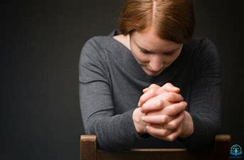
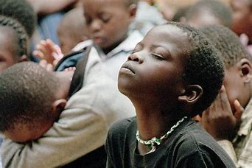
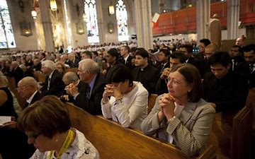
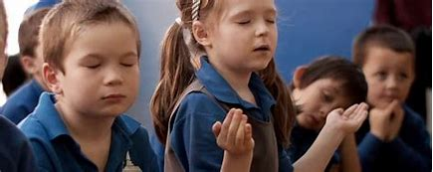
What might these images teach us about prayer? What questions would you ask?

Slide 5
What might these images teach us about prayer?
What questions would you ask these people?
Do you need words to pray?
Can you pray anywhere?
Can you pray alone or with others?

Slide 6
A thought to take away…
Prayer is a way to communicate with God. An adventure with many possibilities…
Christians believe you can pray anywhere, at any time. It might be asking something, saying thank you or maybe saying nothing at all. It doesn’t have to be formal, can be long or short and there is no way you can get it wrong!
Think about the sorts of prayers you have in school. Are there some new prayer adventures to try?

Slide 7
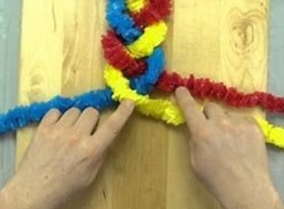
Today’s Challenge
If you would like to join in with today’s challenge, why don’t you:
Make a Prayer Plait
Cut three equal lengths of wool in colours of your choice. One colour represents yourself, one represents God and one represents other people. Knot them together at one end. As you plait the wool, say a prayer for yourself and something you worry about, say thank you to God for someone or something special to you and then ask God to help someone who may need it at the moment.
or
Write or say a Spoon prayer (you might even want to decorate a spoon)!
The letters of SPOON can be used to help think about different types of prayer:
S - saying sorry
P - praise and saying thankyou
O - others
O - ourselves
N - needs

Slide 8
Celebration 1
If you would like to, you can join in saying these prayers.
A Prayer for the Day
The Rhythm of Life Prayer
Dear God,
Thankyou for the gift of praye
For quiet prayers and noisy prayers
For prayers alone and prayers with others
For old prayers and new prayers
For today’s prayers.
Amen
Loving God,
Help me to learn from you
the habit of praying,
so that the rhythm of my life
can match
the rhythm of your heart of love.
Amen

Slide 9
This resource was produced by the Diocese of Leeds Education Team.
For more information about this or future resources,
please contact your named adviser:
simone.bennett@leeds.anglican.org
simon.sloan@leeds.anglican.org
darren.dudman@leeds.anglican.org
janet.tringham@leeds.anglican.org
lee.talbot@leeds.anglican.org
rupert.madeley@leeds.anglican.org

