Slide 2
Diving into Mastery Guidance for Educators
Each activity sheet is split into three sections, diving, deeper and deepest, which are represented by the following icons:
These carefully designed activities take your children through a learning journey, initially ensuring they are fluent with the key concept being taught; then applying this to a range of reasoning and problem-solving activities.
These sheets might not necessarily be used in a linear way. Some children might begin at the ‘Deeper’ section and in fact, others may ‘dive straight in’ to the ‘Deepest’ section if they have already mastered the skill and are applying this to show their depth of understanding.
Diving
Deeper
Deepest

Slide 3
Aim
Identify, represent and estimate numbers using different representations.

Slide 4
1000s, 100s, 10s and 1s
Diving
Work out the value of each number shown and give your answer in words and numerals.
Th | H | T | O
1000
100
1000
100
100
10
1
1000
100
100
1000
100
10
two thousand, three hundred and fifty-six
2356
one thousand and seventy-two
1072
four thousand, six hundred and twenty-one
4621

Slide 5
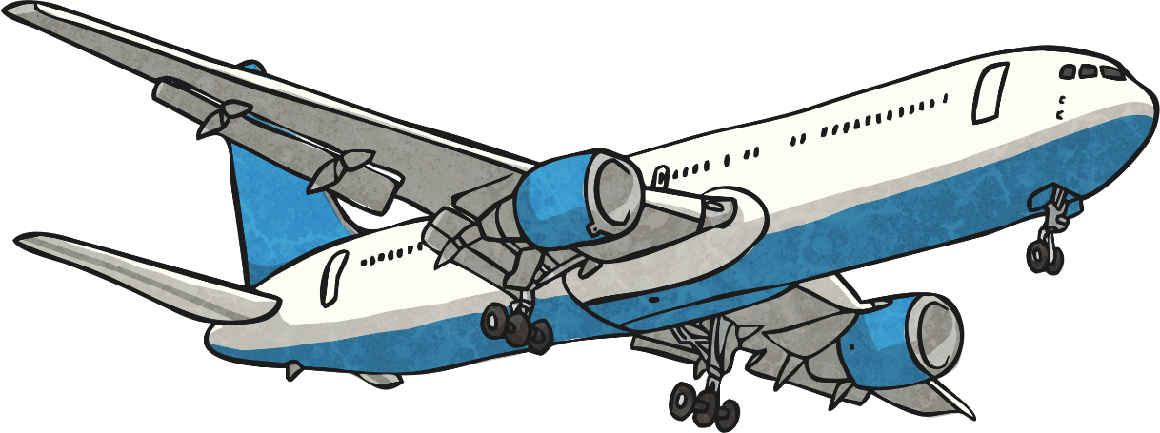
1000s, 100s, 10s and 1s
Diving
Complete the part-whole model to identify how many passengers travelled with Twinkl Travel in one day.
4385
eight tens
1000
1
1000
1
1
1
1000
1000
1

Slide 6
1000s, 100s, 10s and 1s
Deeper
The baggage handlers have been sorting suitcase numbers onto the Venn diagram.
Use your knowledge of place value to check the Venn diagram. Can you spot the mistake?
three tens
three thousands
3301 is incorrect. While the number does have three thousands, it doesn’t have three tens. This should just be in the ‘three thousands’ section.
530
3303
3737
38
3291
3301
3301
1039
3606

Slide 7
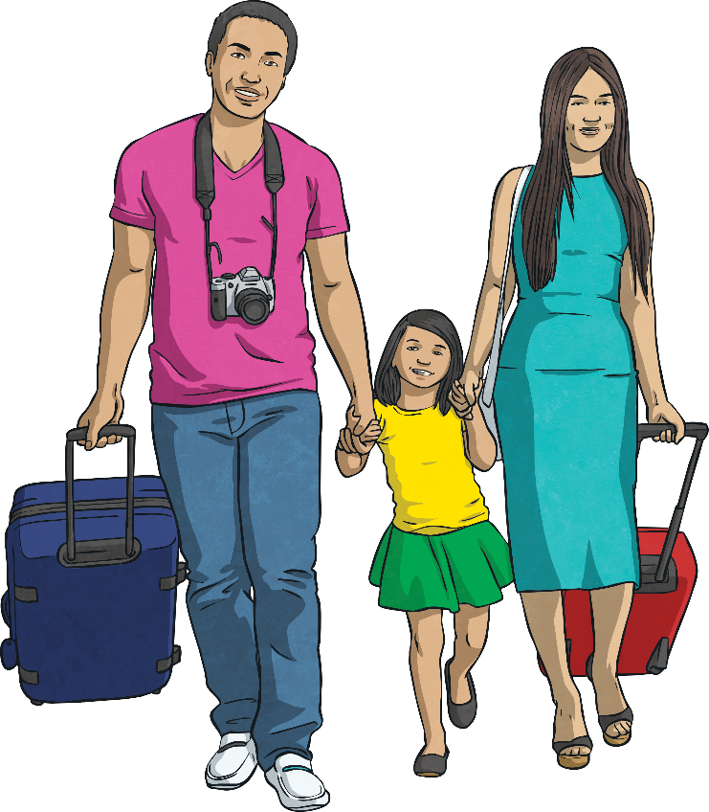
1000s, 100s, 10s and 1s
Deeper
Flight number eight thousand, eight hundred and five is boarding.
Read the statements about the flight number and identify which are true and false.
Eight thousand, eight hundred and five has a zero in the ones place in the number.
Eight thousand, eight hundred and five has the same number of hundreds as it does thousands.
False
The zero would be in the tens place.
True
There are eight hundreds and eight thousands.

Slide 8
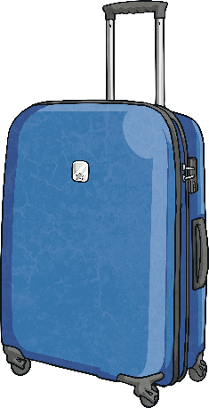
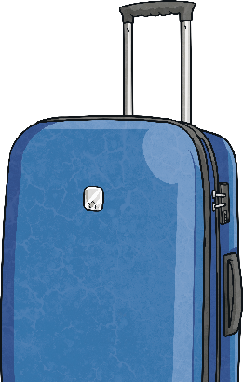
1000s, 100s, 10s and 1s
Deepest
The suitcases have become muddled.
Using the clues below, can you match each suitcase to the correct owner?
Tara
My number has an even number of hundreds.
What other clue could Fiona have given about her number?
6822
Accept any correct clue, such as the number has sixty-four tens.
Simon
My number has the same number of thousands as it does hundreds.
6608
6822
Fiona
My number has a placeholder.
6608
6440
6440

Slide 9
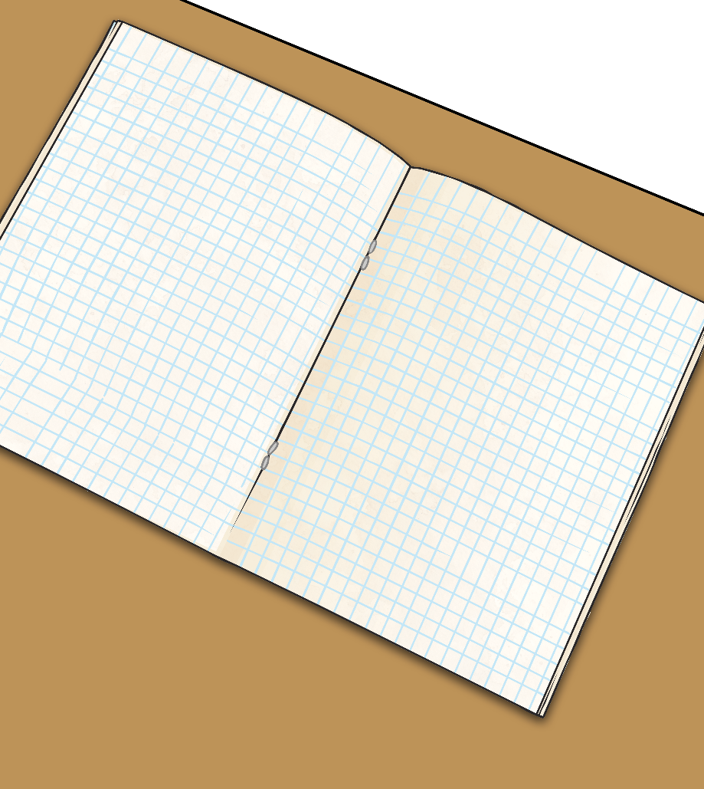
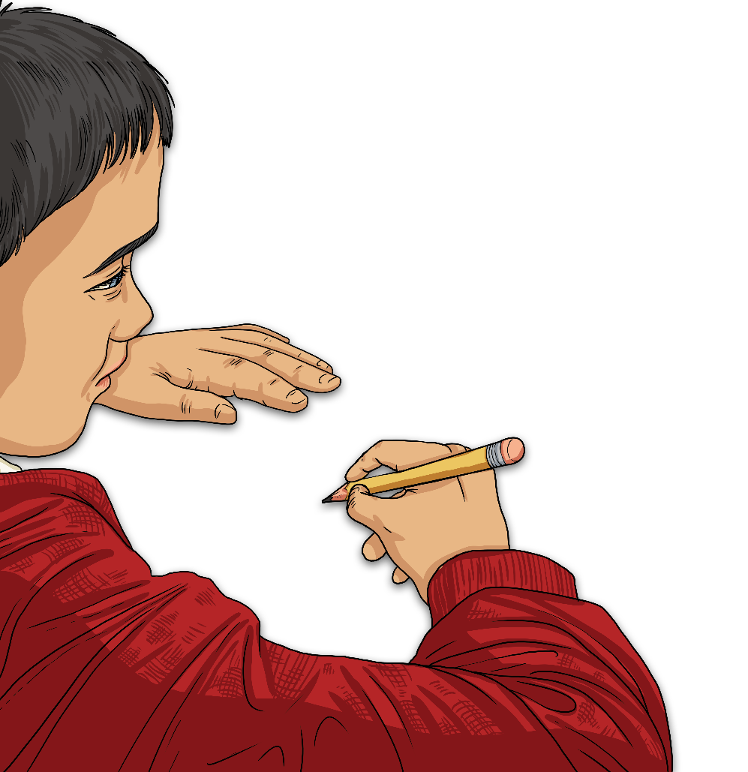
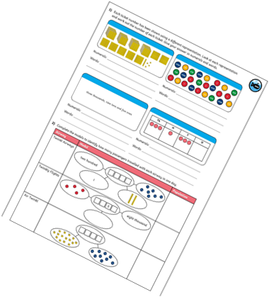
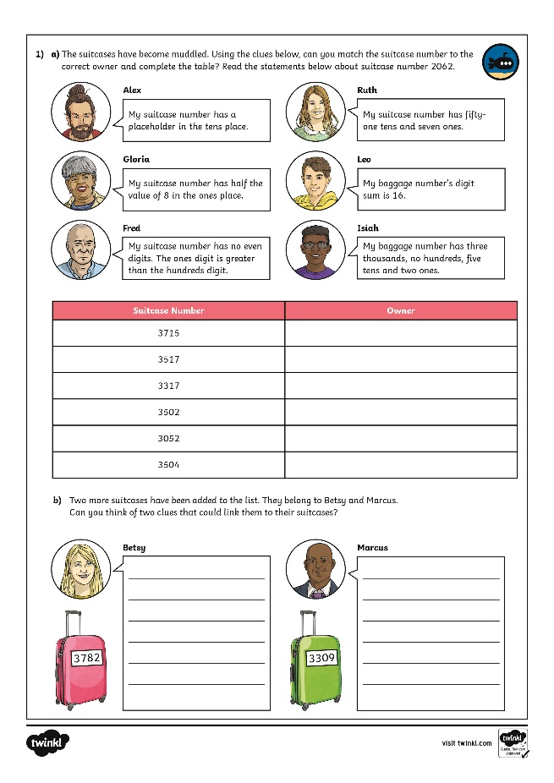
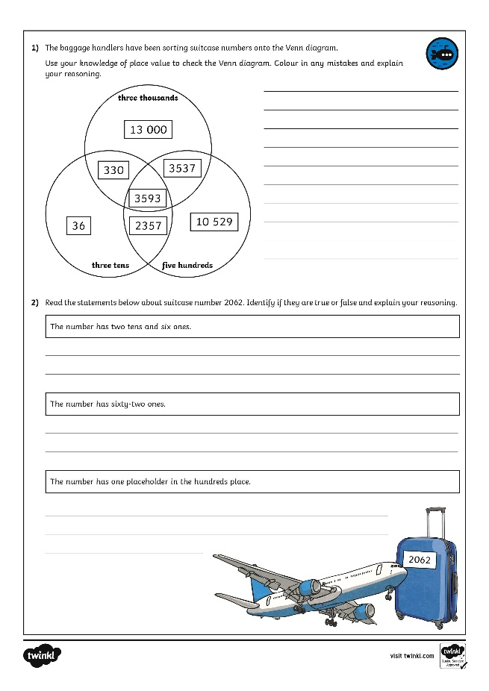
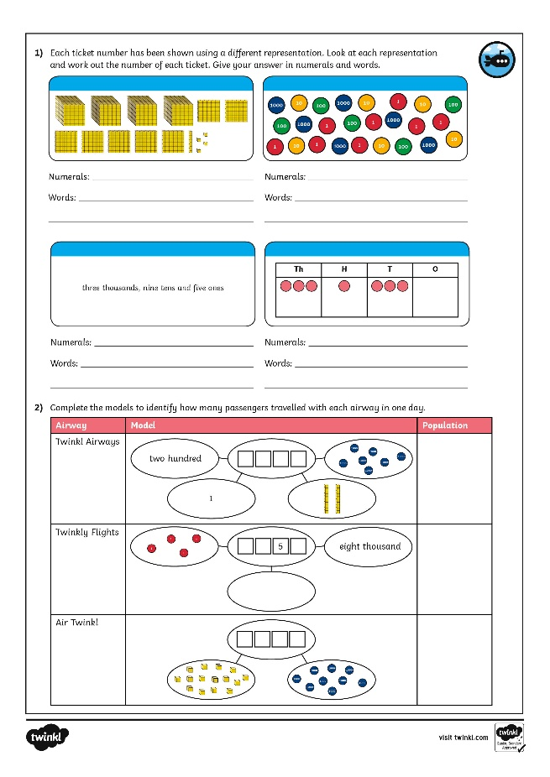
1000s, 100s, 10s and 1s
Dive in by completing your own activity!

Slide 10
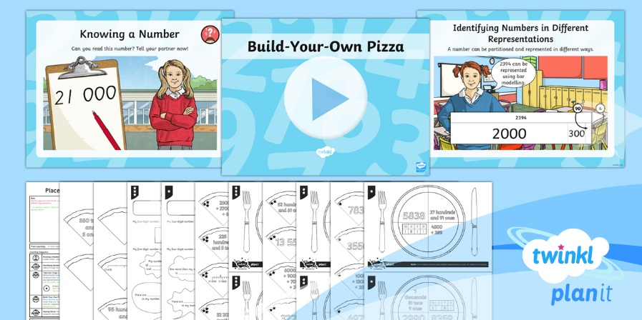
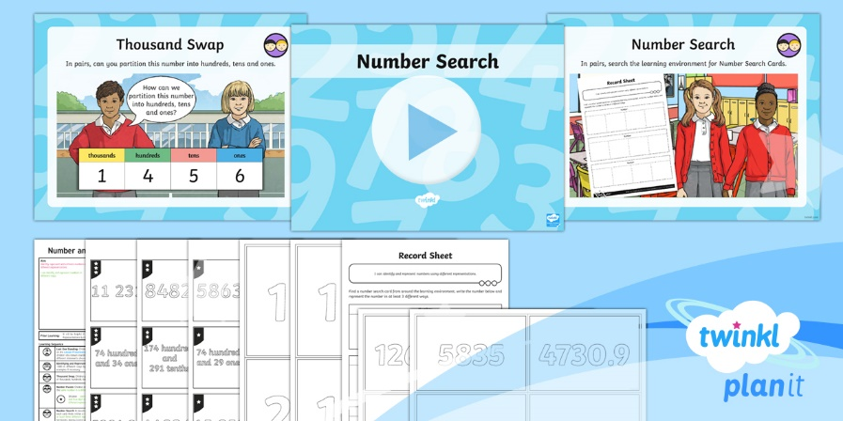
Need Planning to Complement this Resource?
National Curriculum Aim
Identify, represent and estimate numbers using different representations.
For more planning resources to support this aim, click here.
Twinkl PlanIt is our award-winning scheme of work with over 4000 resources.

