Slide 1
Reflecting

Slide 2
Today we are looking at reflecting, as we continue to think about Jesus’ temptation in the wilderness.
Before we start, consider these questions:
Do you want other people to think you are important?
How would you go about achieving this?

Slide 3
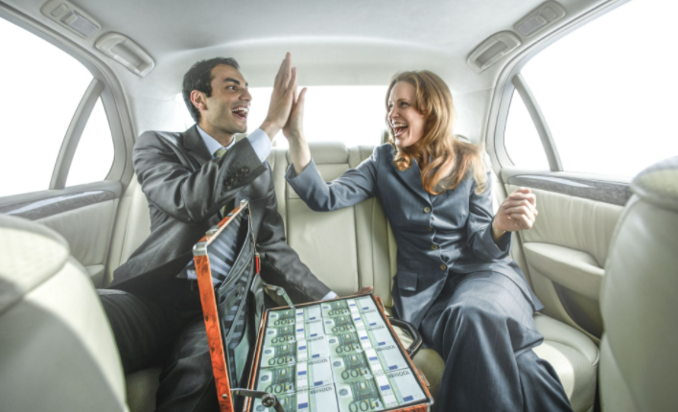
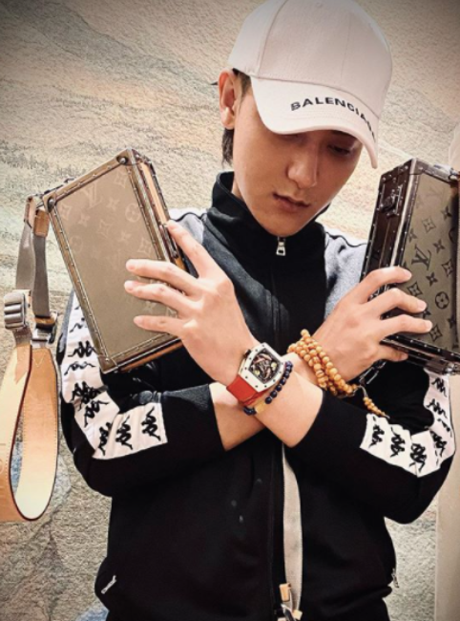
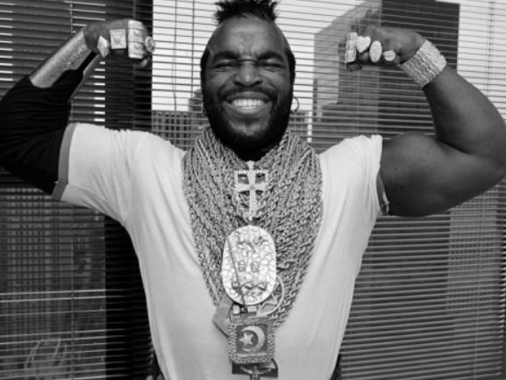
Look at these images:
What reactions do you think they are trying to get from us?
How do you actually respond to these images?

Slide 4
In Luke’s gospel we read the next part of the story of Jesus’ temptation in the wilderness.
Luke – Chapter 4
⁵ Then the devil took Jesus and showed him all the kingdoms of the world in a moment of time. ⁶ The devil said to Jesus, “I will give you all these kingdoms and all their power and glory. It has all been given to me, and I can give it to anyone I wish. ⁷ If you worship me, all will be yours.”
⁸ Jesus answered, “It is written in the Scriptures: ‘You must worship the Lord your God. Serve only him!’”

Slide 5
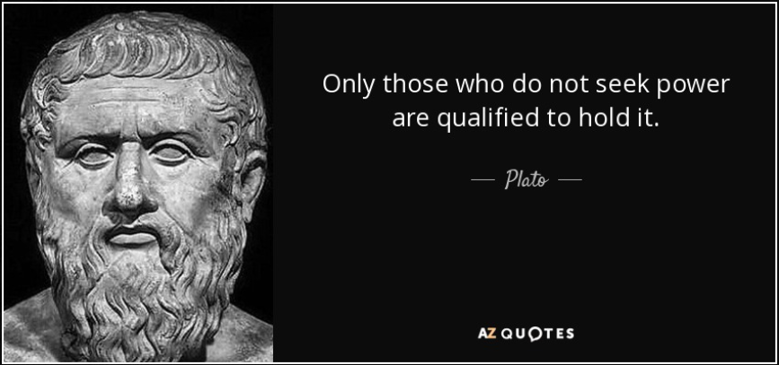
A famous ancient thinker called Plato said this:
What do you think he meant by this?
How does this relate to how Jesus behaved in the story?
How would you have responded in that situation?

Slide 6
A thought for today…
Christians believe that Jesus did not need to grab power or attention. He knew that God was in charge and loved him - that was enough for him.
Anyone who has a talent does not have to shout about it. We see how good they are from what they do not what they say.
Reflecting helps us recognise the things that are really important in life. We see that grabbing power or showing off don’t make us special. It is how we live and how we care for others that makes us truly stand out.

Slide 7
Find a way today to let someone else take the limelight or receive the praise for something. How does it make them feel? How does it make you feel?
or
Think of someone who is important to you. What is it about them or their behaviour that makes them important? Choose one thing from their example that you will try to follow.

Slide 8
Holy Spirit, help me to live each day confident about who I am and how I am loved by God. Help me show that I am special by the way I live my life, loving other people. Amen

Slide 9
This resource was produced by the Diocese of Leeds Education Team. For more information about this or future resources,
please contact your named adviser:
simone.bennett@leeds.anglican.org
simon.sloan@leeds.anglican.org
darren.dudman@leeds.anglican.org
janet.tringham@leeds.anglican.org
lee.talbot@leeds.anglican.org
rupert.madeley@leeds.anglican.org

