Slide 2
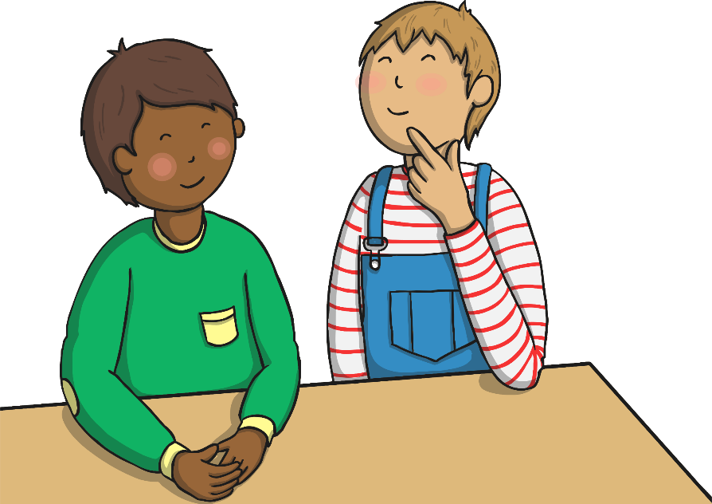
Homophones
These words all sound the same, but they are spelt differently, and have different meanings.
to
too
two

Slide 3
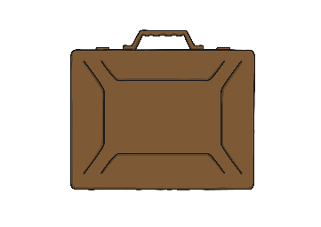
to
‘to’ is a preposition when it comes before a noun.
The children are going to the shop.
They went to London.
‘to’ is usually (but not always) used before the infinitive form of a verb. The infinitive form of a verb just means a verb in its most basic form.
I need to go to work today.
I’m going to tidy the house tomorrow.
‘to’ has lots of meanings, but if ‘too’ and ‘two’ don’t make sense, you probably need to use ‘to’!

Slide 4
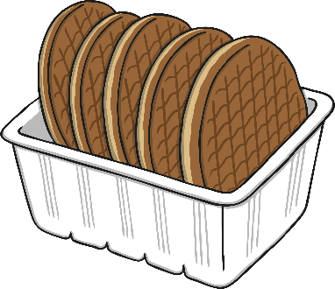
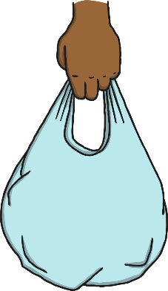
too
‘too’ can mean ‘as well’ and ‘also’.
May I come shopping too?
I like cakes, but I like biscuits too.
‘too’ can also be used to show excess.
I have eaten too much food.
The bag was too heavy.

Slide 5
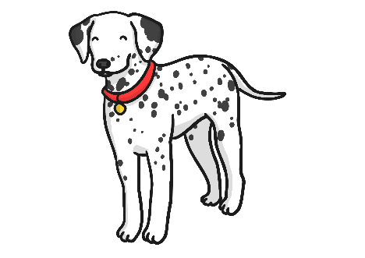
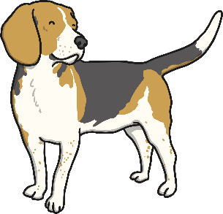
two
‘two’ means the number ‘2’.
There are two dogs running in the park.
I have two brothers and one sister.

Slide 6
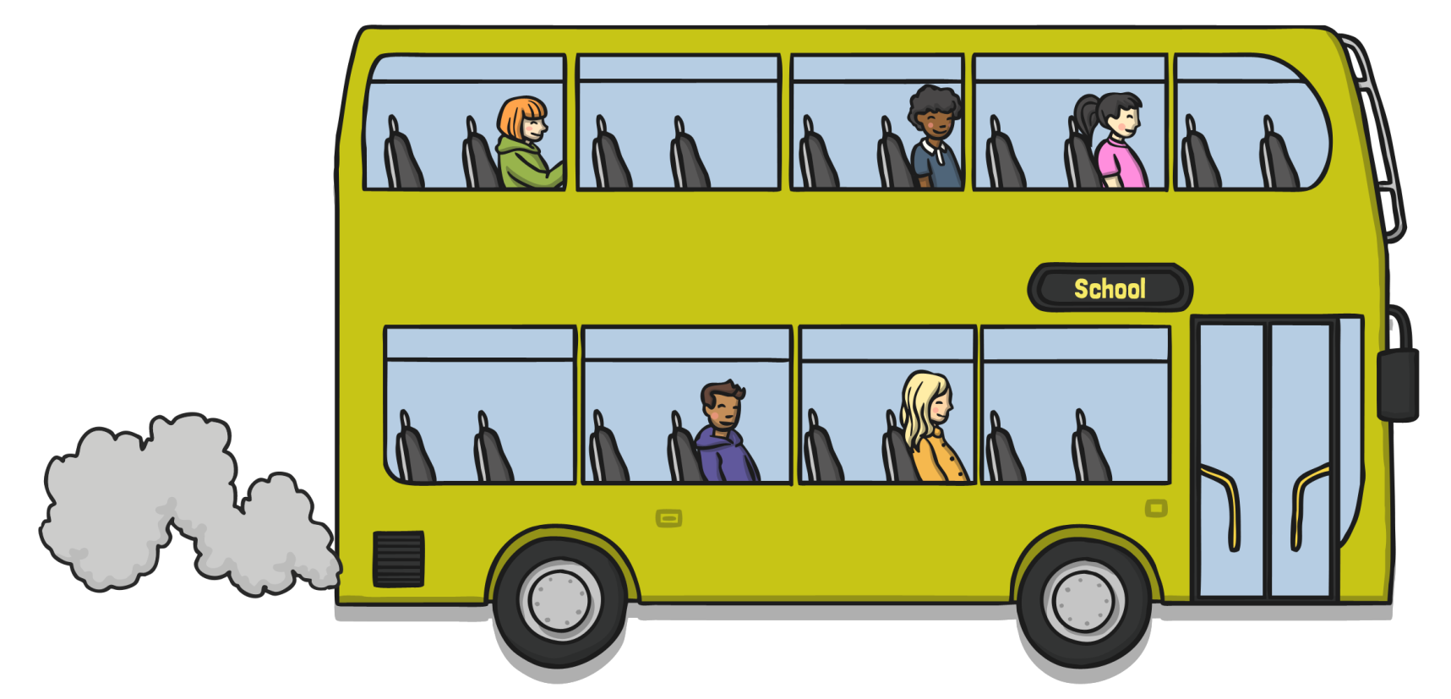
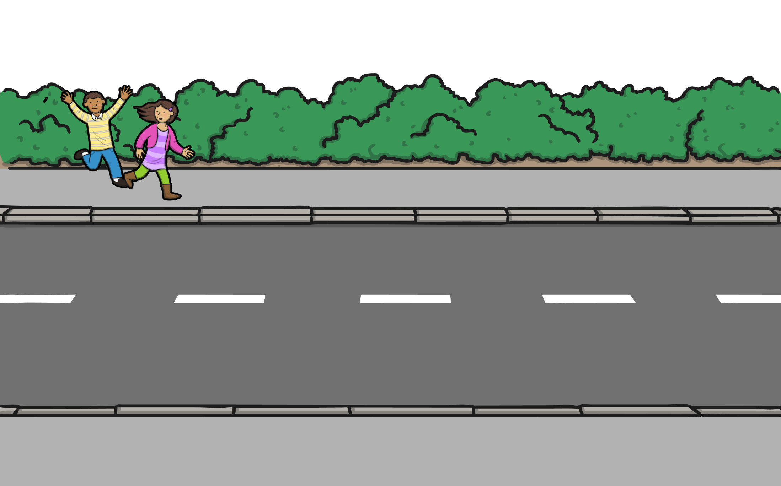
to, too and two
Two children wanted to catch the bus to school, but they were too late.

