Slide 1
Story part 1 –
Jesus is Baptised

Slide 2
Lent is the time when Christians prepare for Easter.
Jesus has a difficult journey ahead of him.
As our Rhythm of Life Lent story begins, we meet Jesus being baptised by John in the River Jordan and preparing himself for the events that will come later.
Click the video to watch or move on to the next slide to read the first part of the story ….

Slide 3
You can read about this in Matthew’s gospel:
Matthew – Chapter 3
In those days John the Baptist came, preaching in the wilderness and saying, “Repent, for the kingdom of heaven has come near.” This is he who was spoken of through the prophet Isaiah: “A voice of one calling out in the wilderness, ‘Prepare the way for the Lord, make his path straight.’”
John’s clothes were made of camel’s hair, and he had a leather belt around his waist. His food was locusts and wild honey.
Then Jesus came from Galilee to the Jordan to be baptized by John. But John tried to stop him, saying, “I need to be baptised by you…” But, John agreed and as soon as Jesus was baptised and came up out of the water, at that moment heaven was opened. He saw the Spirit of God coming down like a dove and a voice from heaven said, “This is my Son, whom I love; with him I am pleased.”
Click here if you want to listen

Slide 4
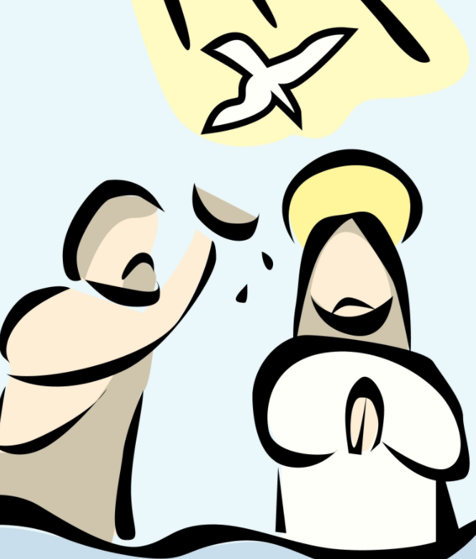
Some questions to help you think about the story…
John the Baptist was preparing people to meet Jesus.
- Can you think of things that you have to prepare for?
- What difference does it make to be prepared?
- Can you prepare for everything?
What sorts of things do you think the people in the story were doing that God wanted them to stop? The Bible calls these sins – can you think of other words we could use?
Jesus didn’t mind how things looked to other people. He wanted to do what God wanted, no matter what. How do you know when you’re doing the right thing? Who or what helps you decide?

Slide 5
Putting the story into action…
What else can you find out about Baptism? If someone in your family has been baptised, you might want to ask them about it.
or
Think about something you want to do even better – helping at home, keeping your room tidy, reading more…make a commitment and ask someone to help you to stick to it!

Slide 6
One of the most well known Christian prayers is The Lord’s Prayer.
You may want to say it as you think about the story.
Our Father in heaven, hallowed be your name, your kingdom come, your will be done, on earth as in heaven. Give us today our daily bread. Forgive us our sins as we forgive those who sin against us. Lead us not into temptation but deliver us from evil. For the kingdom, the power, and the glory are yours now and for ever. Amen.
Click here to find out more about the Lord’s Prayer.
You can also watch a video to learn it in sign language too….

Slide 7
This resource was produced by the Diocese of Leeds Education Team. For more information about this or future resources,
please contact your named adviser:
simone.bennett@leeds.anglican.org
simon.sloan@leeds.anglican.org
darren.dudman@leeds.anglican.org
janet.tringham@leeds.anglican.org
lee.talbot@leeds.anglican.org
rupert.madeley@leeds.anglican.org

