Slide 1
Welcome to our information meeting about Accelerated Reader.
11.11.24

Slide 2
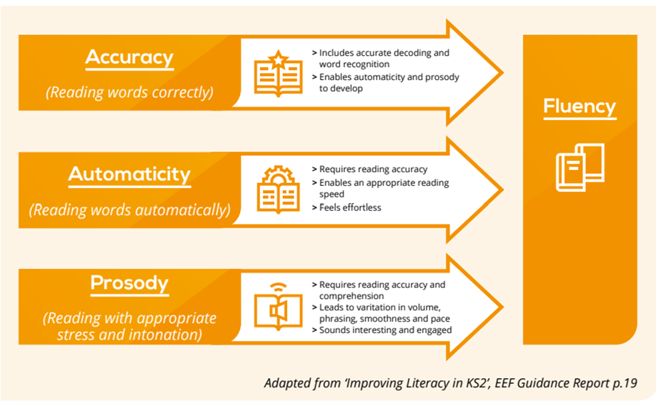
Why have we introduced a reading scheme?

Slide 3
“Fluency does not guarantee comprehension, but a lack of fluency guarantees, almost all of the time, a lack of comprehension, especially with more complex texts.” (Liben, 2015)

Slide 4
So, why Accelerated Reader?

Slide 12
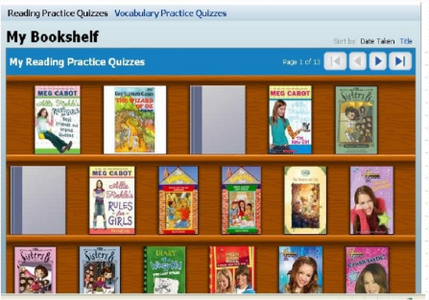
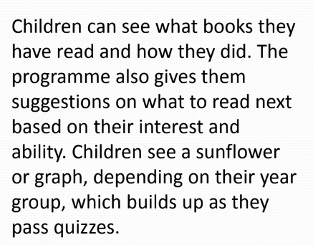
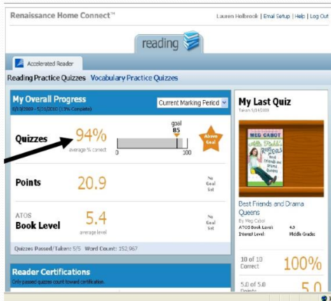
What the children can see…
They can see how they have done with their quizzes. We aim for 85% or above.

Slide 13
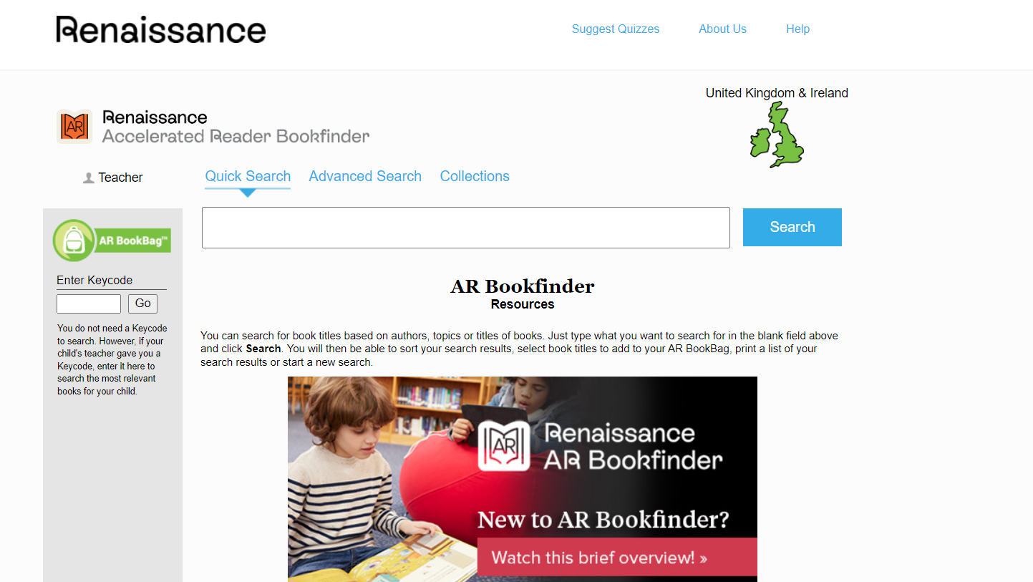
https://www.arbookfind.co.uk/default.aspx

Slide 14
Reading for Pleasure
Along with their AR or phonically decodable book, all children will also be able to choose a free reading book. They can change this weekly or more frequently if needed. The important thing is that the children love to read.

Slide 15
Any Questions?

