Slide 1
Maths
Multiplication and Division
Year One
Maths | Year 5 | Multiplication and Division | Multiples and Factors | Lesson 3 of 3: Common Factors

Slide 2
Common Factors

Slide 3
Aim
I can find the common factors of two numbers.
Success Criteria
I can find the factors of numbers.
I can use factor trees to find the common factors of two numbers.

Slide 4
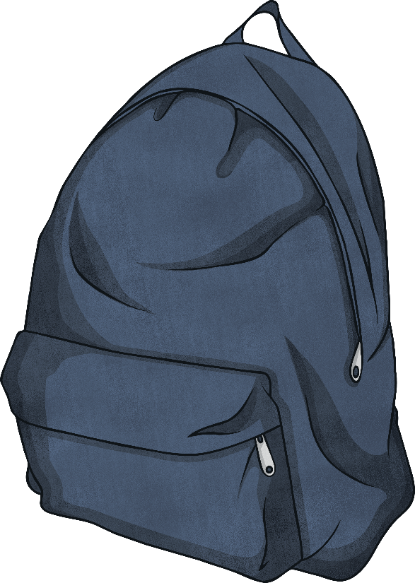
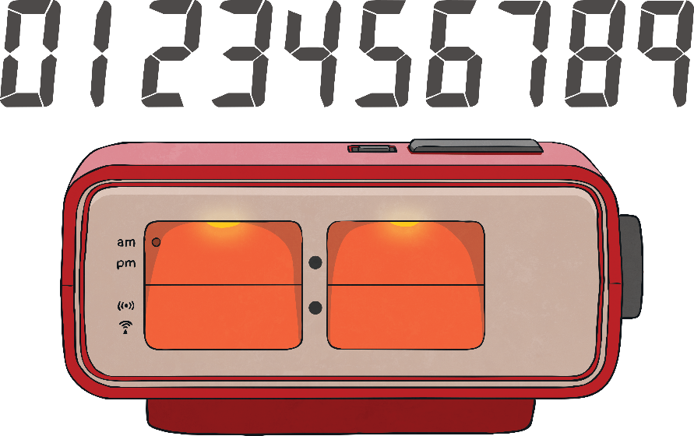
Beat the Clock
Your teacher will tell you which columns to complete.
If you got them all correct - well done! Next time, try to improve your time or choose a more tricky multiplication table.
The stopwatch will stop after 3 minutes.
If you finish before the 3 minutes is up, shout ‘finished’ and your teacher will tell you your time. Write this at the top of the sheet.
When your work is marked, you will have a score to write at the top too.
Click on the clock to begin the countdown.
If you didn’t get them all right, focus on that next time. Don’t worry if it takes you the full 3 minutes.
Remember that you are racing against yourself. Don’t worry about what your friends are doing!
Time’s Up!

Slide 5
What Is a Factor?
Factors are numbers you can multiply together to get another number.
8 and 4 are factors of 32 because 8 × 4 = 32.
This factor rainbow shows all the factor pairs for 32.
How do we find all the factors of numbers?
One way is to draw a factor rainbow.
1
2
4
8
16
32

Slide 6
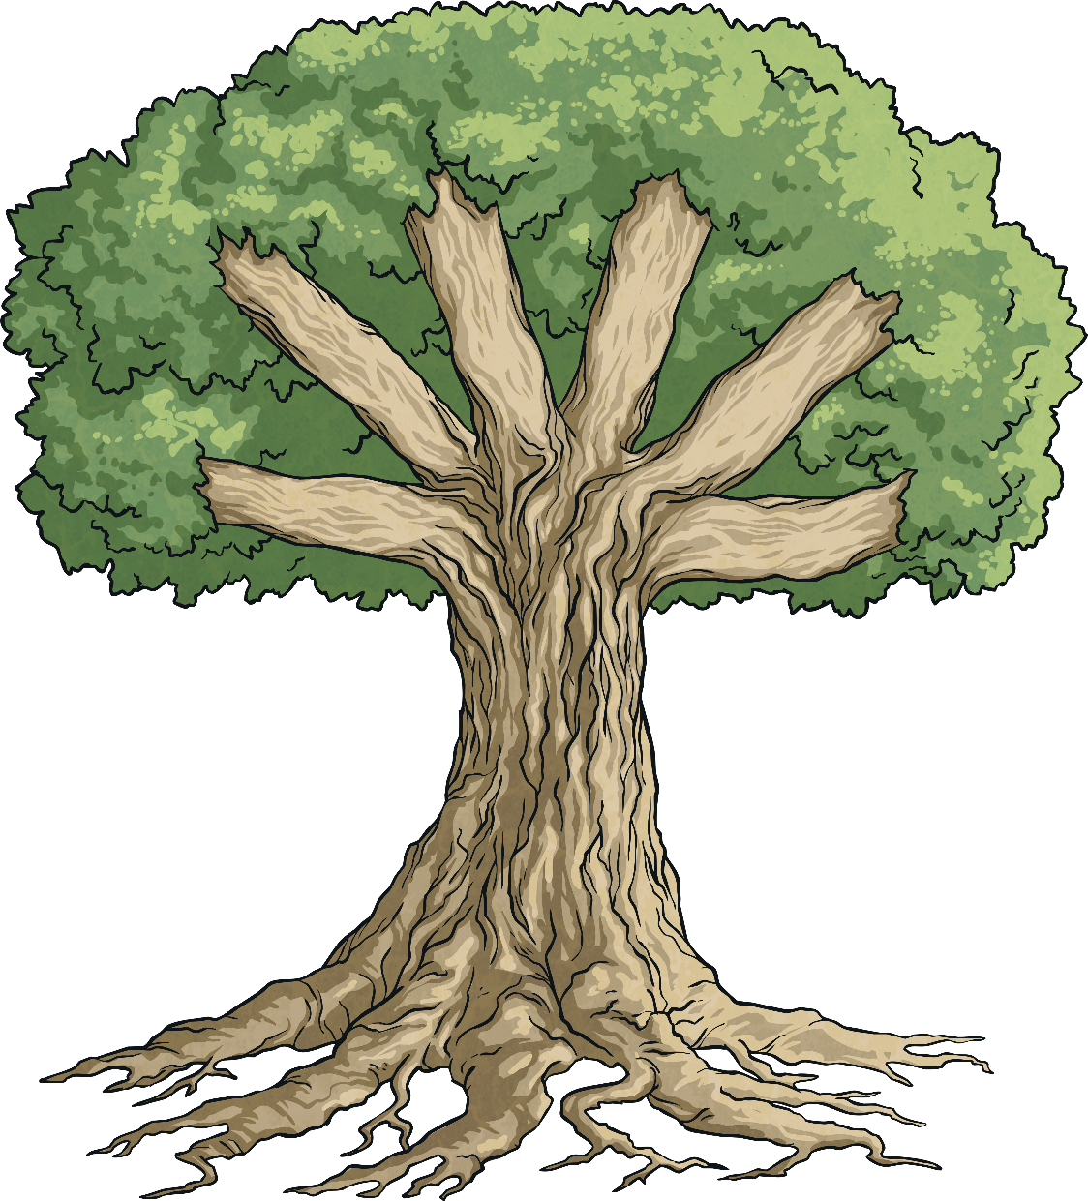
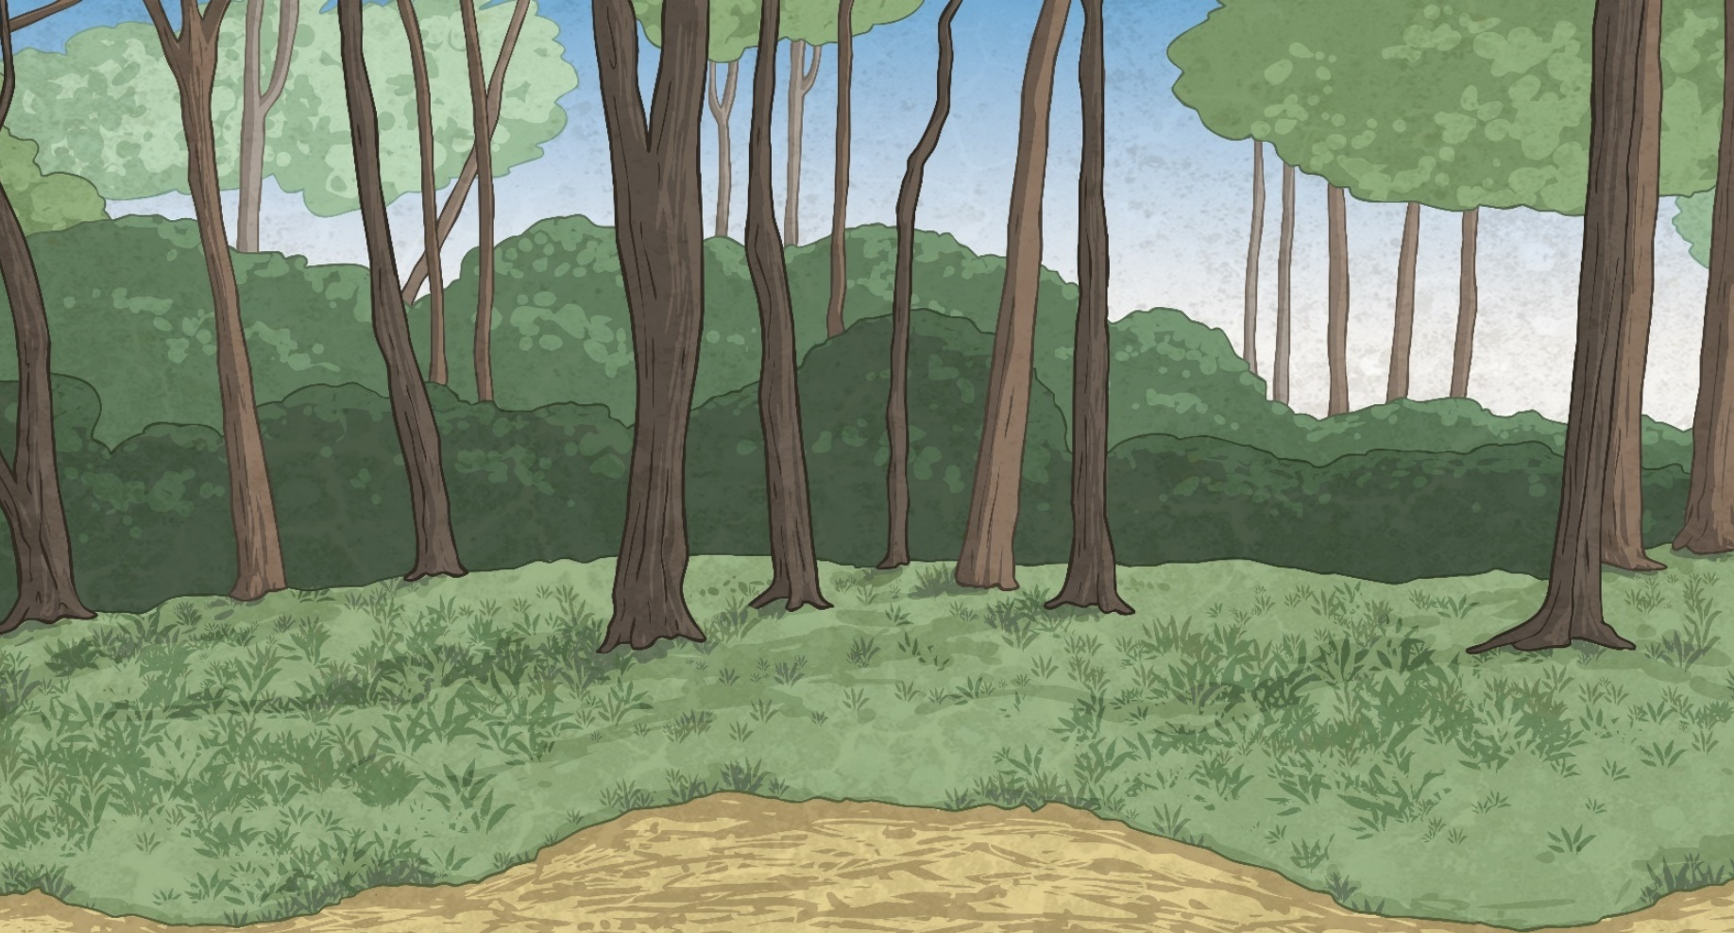
Factor Trees
You can also draw factor trees to show the factors of numbers.
1 × 24
2 × 12
1 × 18
2 × 9
3 × 8
3 × 6
24
4 × 6
18
Find all the pairs of factors for the number.
Find all the pairs of factors for the number.
Let’s try another number.
Write the number in the circle.

Slide 7
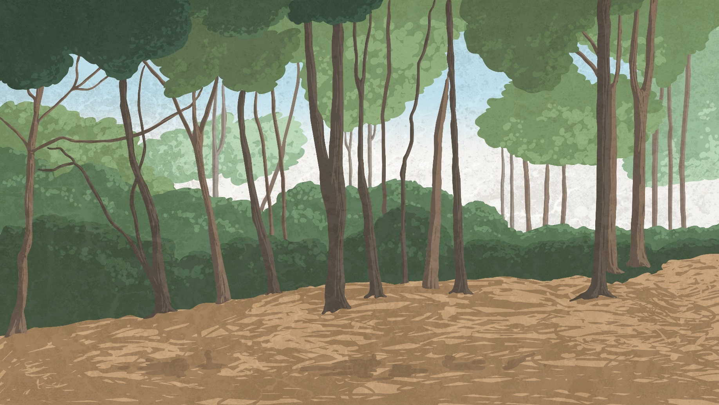
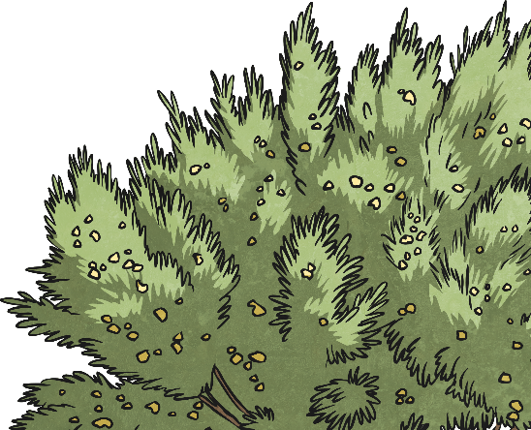
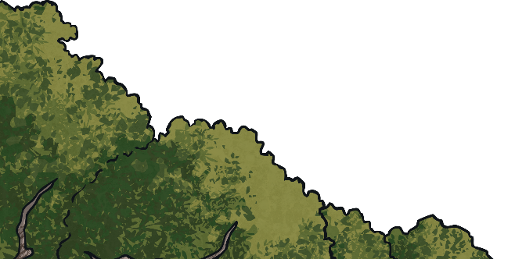
Factors in Common
Look for factors that appear in both trees. These are called common factors.
2
2
2 × 9
3
6
2 × 12
3
3 × 6
3 × 8
1
1
1 × 18
1 × 24
6
4 × 6
18
24
Highlight the factors that both numbers have in common.
The common factors of 18 and 24 are 1, 2, 3 and 6.

Slide 8
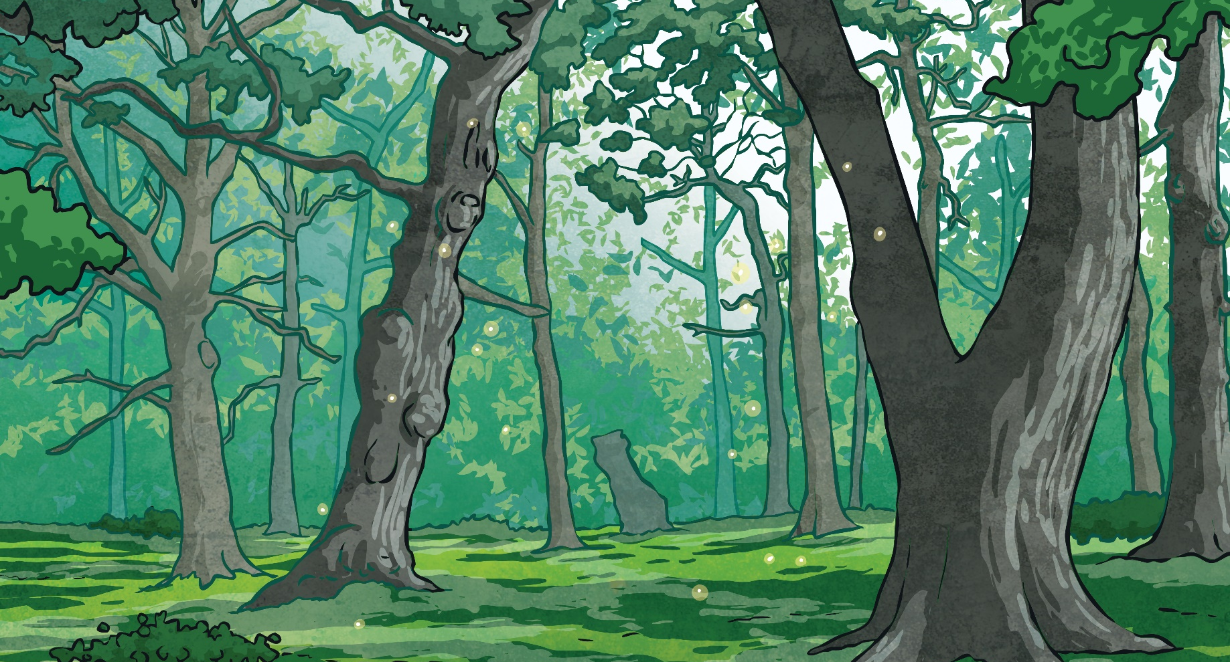
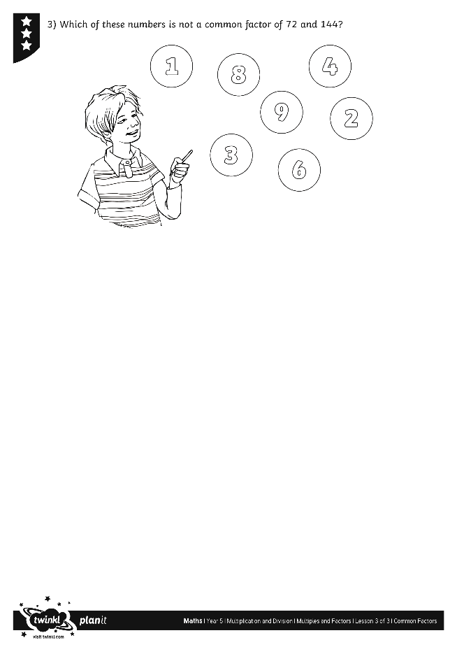
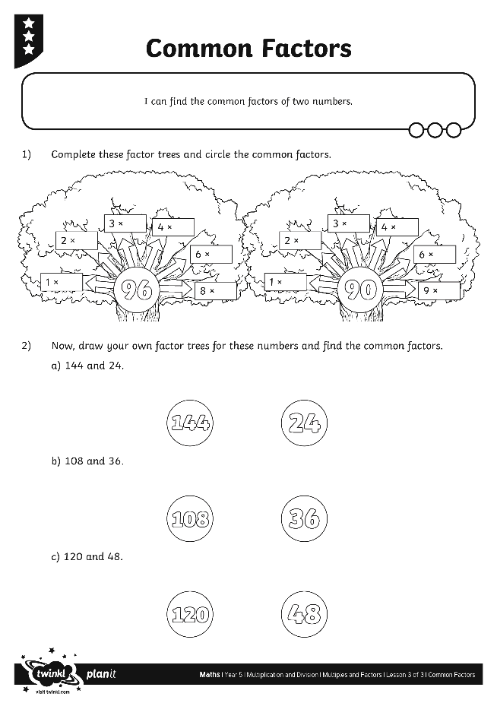
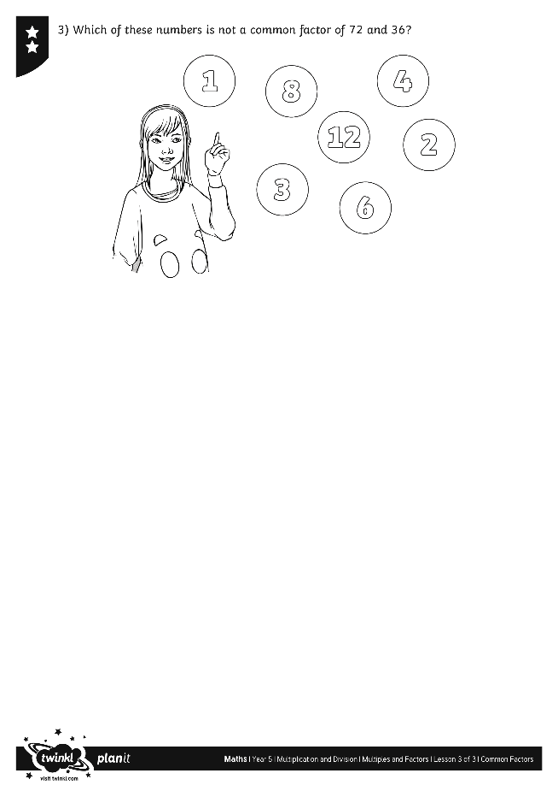
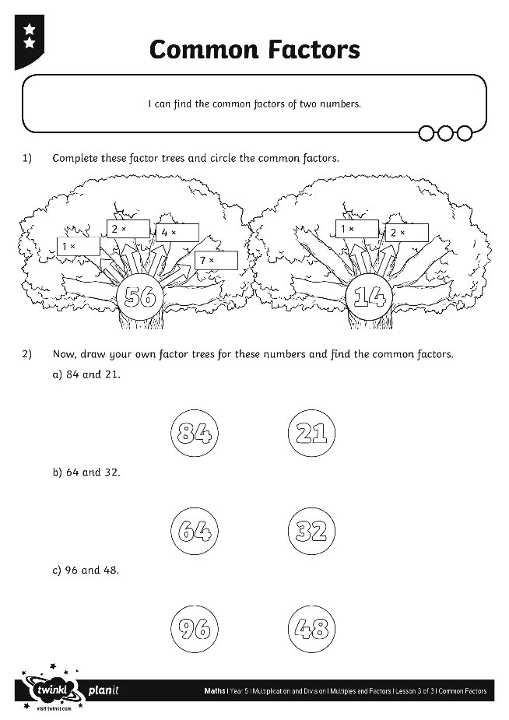
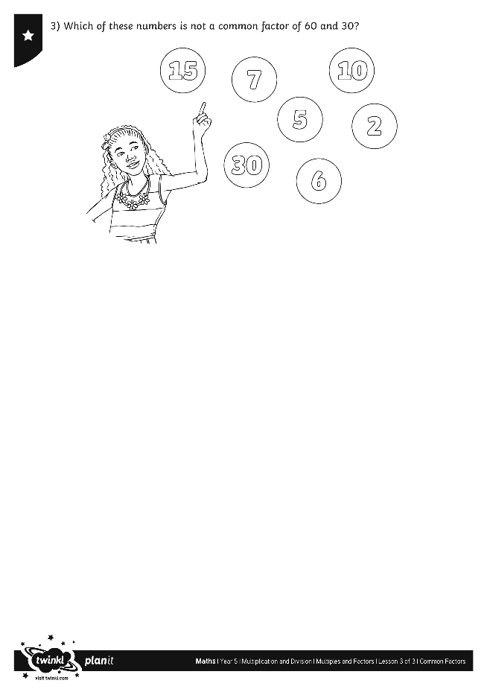
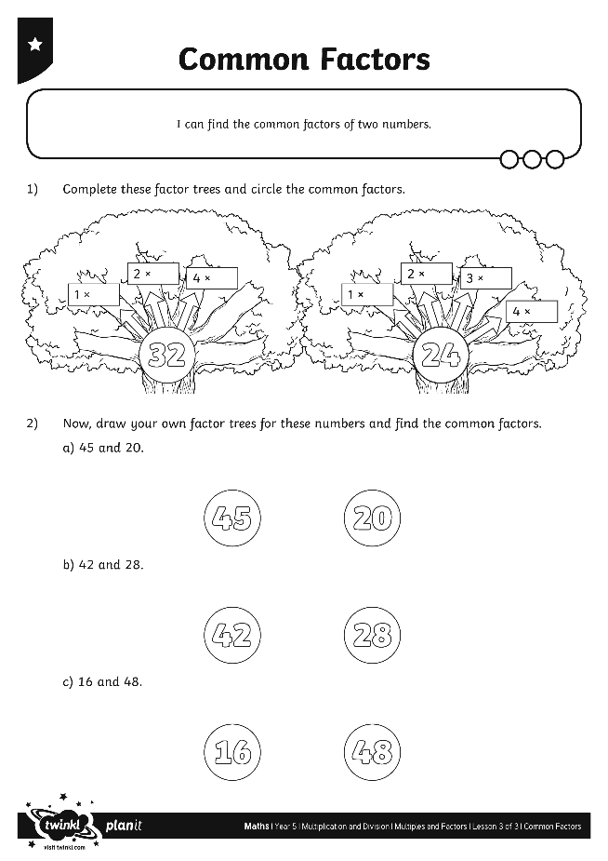
Common Factors
Use your marvellous maths skills to complete these activity sheets:

Slide 9
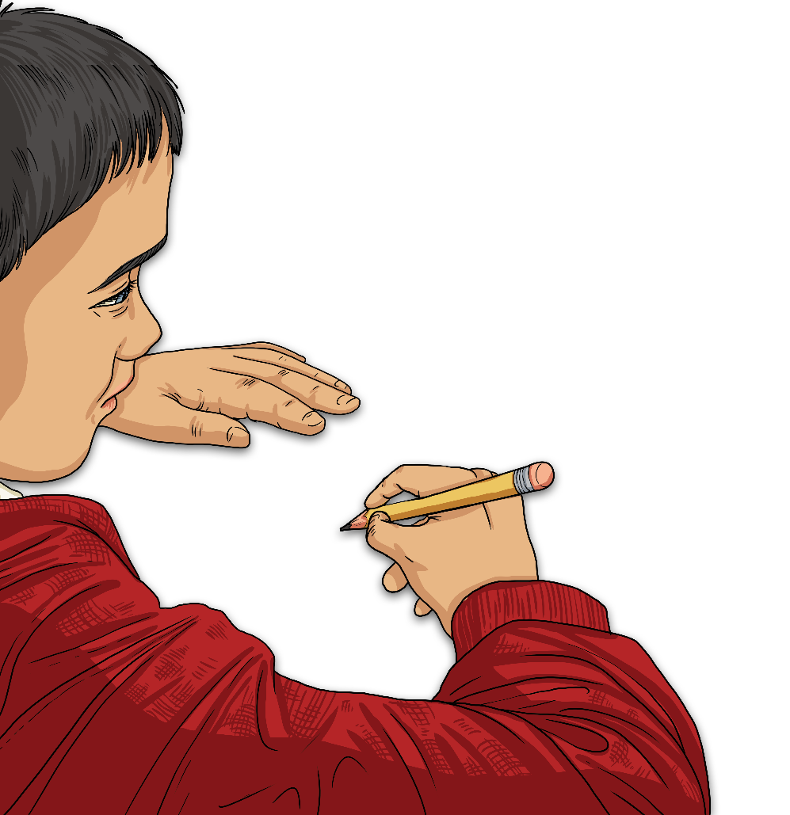
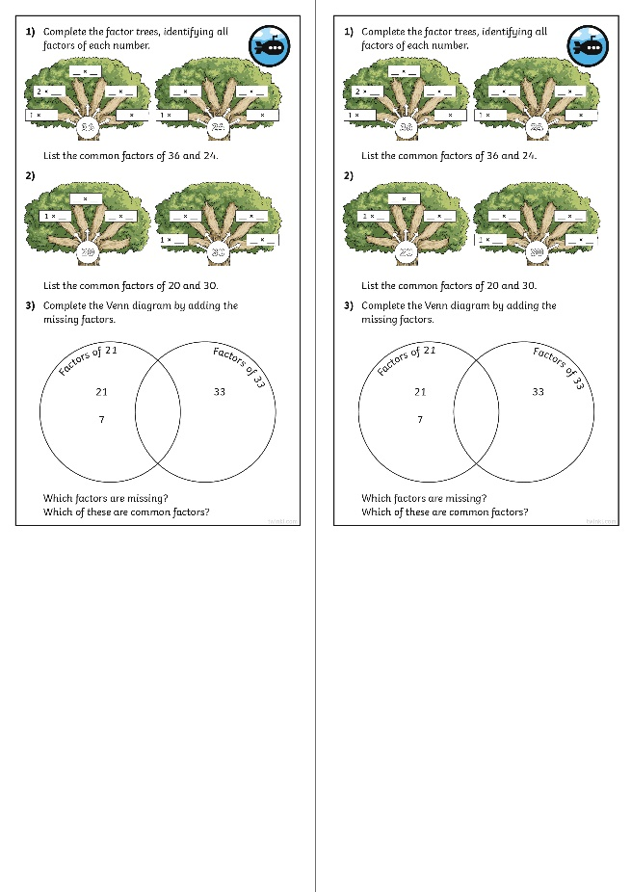
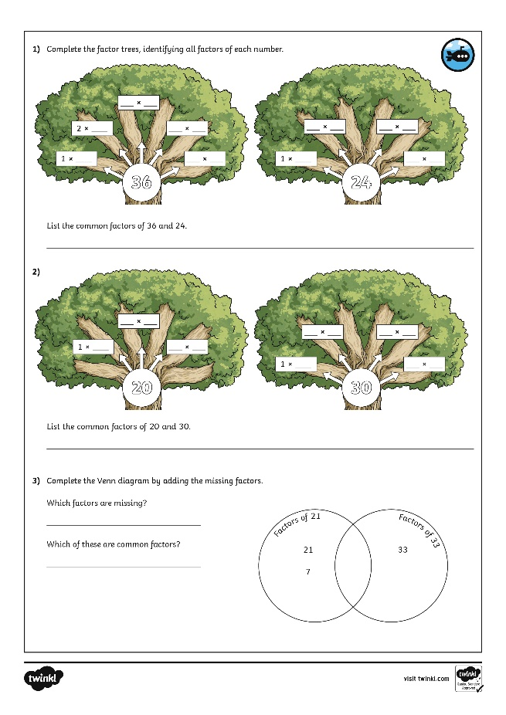
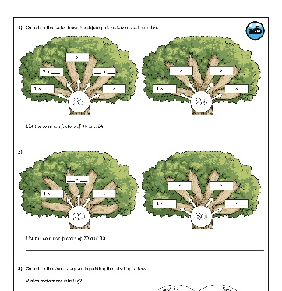
Diving into Mastery
Dive in by completing your own activity!

Slide 10
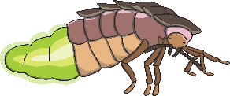
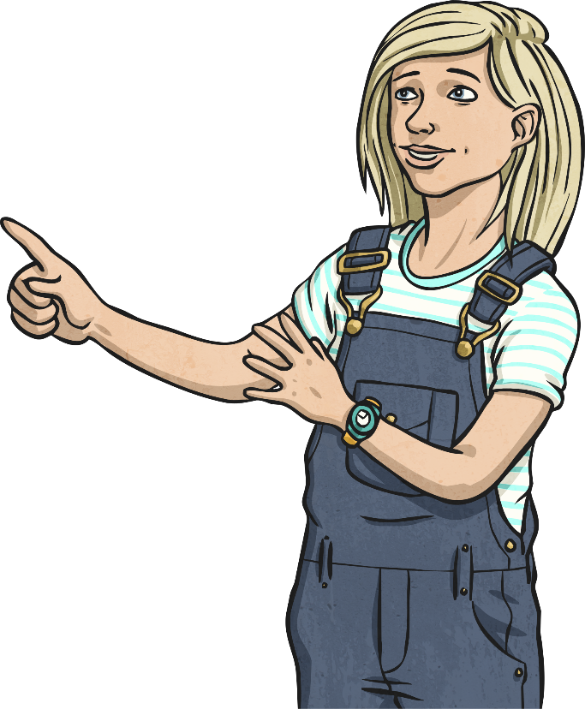
Common Factors of Three Numbers
Which of these numbers is a common factor of 20, 16 and 44?
Which of these numbers is a common factor of 36, 18 and 54?
4
5
12
10
9
4
9
7

Slide 11
Aim
I can find the common factors of two numbers.
Success Criteria
I can find the factors of numbers.
I can use factor trees to find the common factors of two numbers.

