Slide 1
The Rhythm of Life Advent Journey
Sharing

Slide 2
Have a thoughtful look at these images.
Which of these things would you be
happy to share?

Slide 3
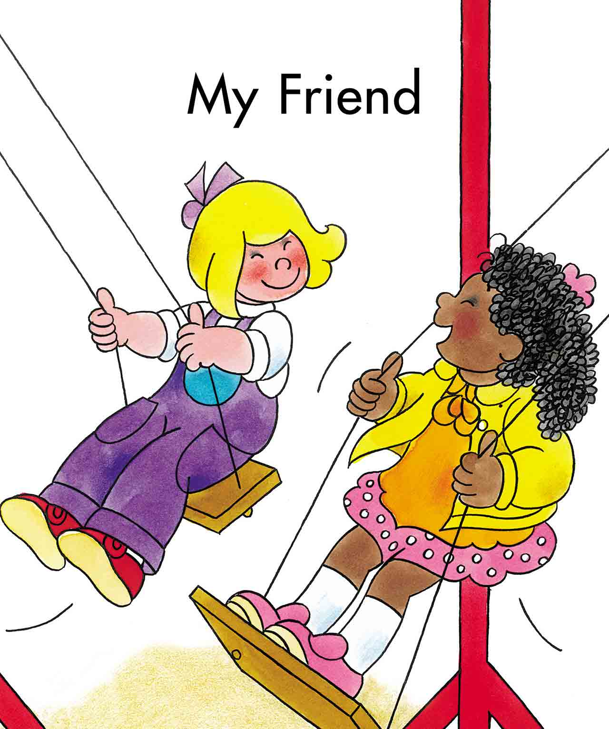
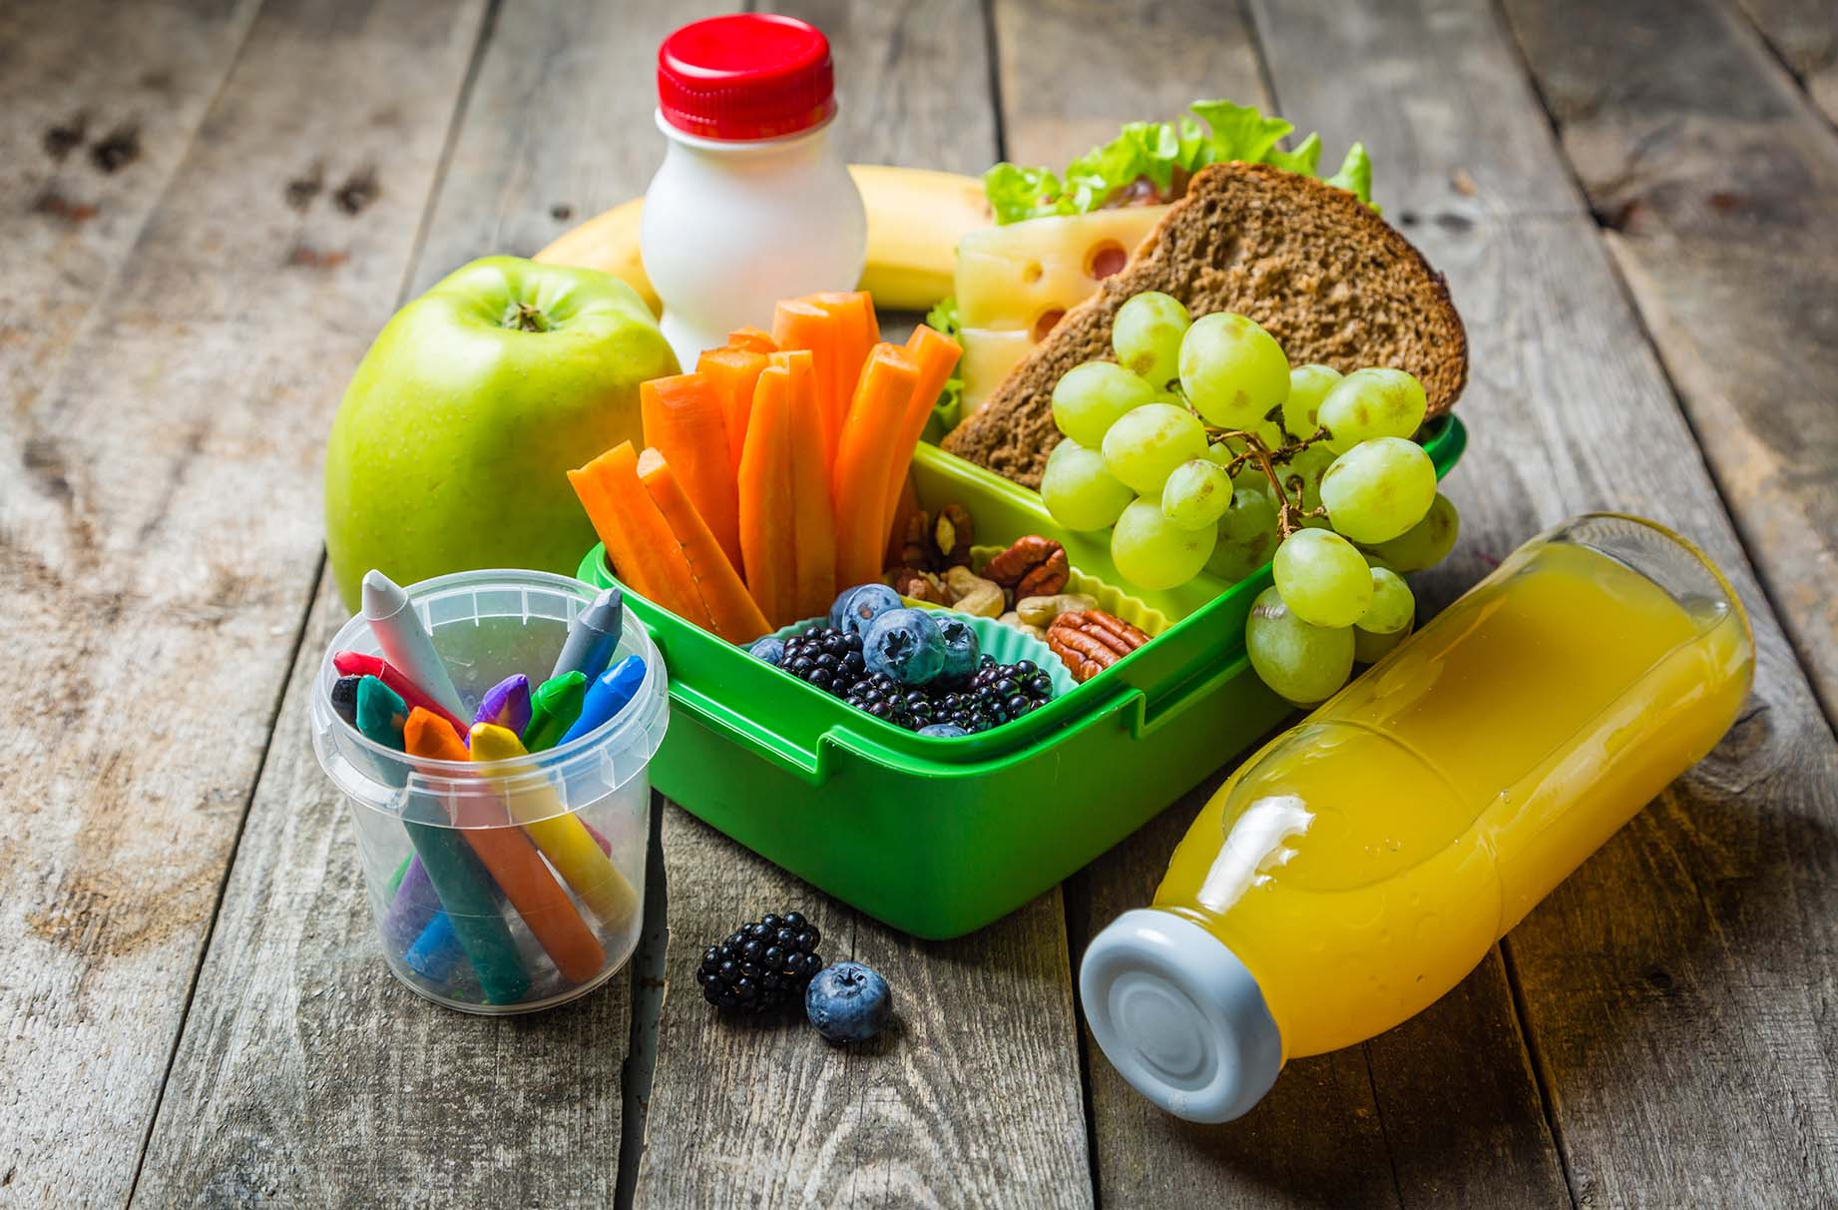
Which of these things would you be happy to share?

Slide 4
How would sharing each make the person receiving them feel?
Would some of these things be easier to share than others? Why?
What other things can we share with other people each day?

Slide 5
A thought to take away…
We know that some things are easier to share than others, but finding a way to share something with someone each day is a gift that we all have. The most precious things you can share with others are your own special gifts – your time, your patience, and your love. Learning to share is one of the first things we learn as children, but something we have to practice and develop throughout our whole lives.

Slide 6
Today’s Challenge
If you would like to join in with today’s challenge,
why don’t you:
Draw or paint a festive picture and share it with someone you care about.
or
Share your time with someone today. This could be at home or at school. It could be doing something for or with someone or just spending time enjoying someone’s company.

Slide 7
If you would like to, you can join in saying these prayers.
A Prayer for the Day
The Rhythm of Life Prayer
Heavenly Father,
Please teach me as I walk,
Take me by my hand and
give me the strength to help those who are needy,
Show me the wisdom and the joy in sharing my gifts with others.
Amen
Loving God,
Help us to learn from you
the habit of sharing,
so that the rhythm of our lives can match
the rhythm of your heart of love.
Amen

Slide 8
This resource was produced by the Diocese of Leeds Education Team.
For more information about this or future resources,
please contact your named adviser:
simone.bennett@leeds.anglican.org
simon.sloan@leeds.anglican.org
darren.dudman@leeds.anglican.org
janet.tringham@leeds.anglican.org
lee.talbot@leeds.anglican.org
rupert.madeley@leeds.anglican.org

