Slide 1
Resting

Slide 2
Today, we continue our journey and conclude the story of Jesus’ temptation. Our theme is resting.
Before we start, consider these questions:
How do you feel when you have just completed something really difficult?
Which is more tired: your body or your brain?
What do you do to ‘recharge your batteries’?

Slide 3
Mark’s gospel tells us this part of the story. Let’s revisit the passage…
Mark - Chapter 1
¹² Then the Spirit sent Jesus into the desert alone. ¹³ He was in the desert 40 days and was there with the wild animals. While he was in the desert, he was tempted by the devil. Then angels came and took care of Jesus.

Slide 4
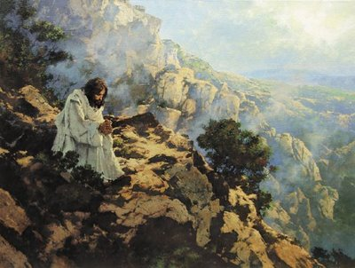
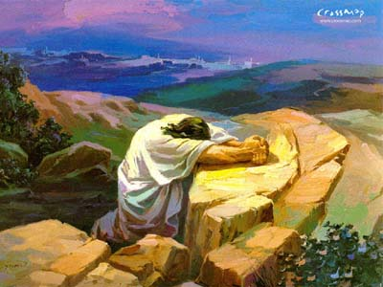
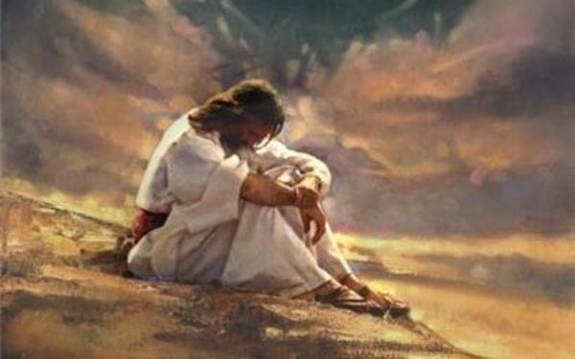
Which of these images of the story is your favourite? Can you say why?
Which one do you think is best at showing how Jesus would have been feeling? Why would he be feeling this?

Slide 5
A thought for today…
Time spent resting is time well spent; it is crucial to make sure our minds and bodies have the time to relax, restore and revive. If we don’t rest, we won’t be at our best or our strongest.
Equally, if we only rest and never take on the challenges ahead, we will also not achieve what we are capable of. Rest has its place in our lives.
Jesus knew that after an ordeal he needed to recharge his batteries to be ready for the next thing. We see him doing it on other occasions throughout the gospels. But the rest was always purposeful, and he always went on to face the next challenge.

Slide 6
Putting resting into action!
You might want to try:
Find a new way to relax at home for at least ten minutes, every day this week (Golden Rule: this cannot involve anything with a screen!)
or
Undertake a job at home so that someone else can have a rest from doing it this week

Slide 7
Heavenly Father, help me to understand the importance of resting my body and my mind. Help me to be calm, fair and strong when I face challenges and to care for others in the way that you care for me. Amen

Slide 8
This resource was produced by the Diocese of Leeds Education Team. For more information about this or future resources,
please contact your named adviser:
simone.bennett@leeds.anglican.org
simon.sloan@leeds.anglican.org
darren.dudman@leeds.anglican.org
janet.tringham@leeds.anglican.org
lee.talbot@leeds.anglican.org
rupert.madeley@leeds.anglican.org

