Slide 1
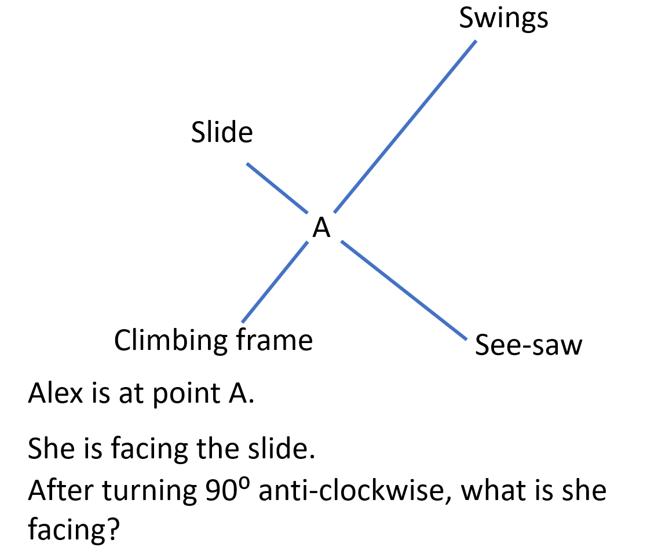
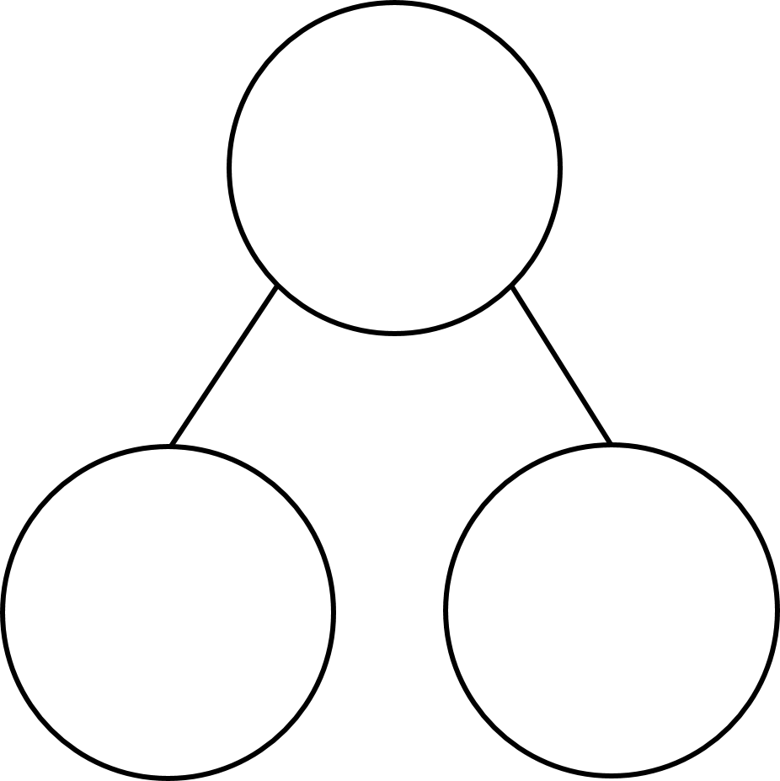
Morning Work - 18/10/2021
180 × ___ = 360
The unit used to measure angles is called ________.
There are ________ degrees in a full turn.
Turning from left to right is called turning ___________.
Turning from right to left is called turning ___________.
What type of angle is this?
What could the size of this angle be?
A B C D
8) Complete the part-whole models.
9)
47⁰
147⁰
90⁰
68⁰
10)
180
360
318
27
166
42

Slide 2
2
180 × ___ = 360
The unit used to measure angles is called ________.
There are ________ degrees in a full turn.
Turning from left to right is called turning ___________.
Turning from right to left is called turning ____________.
degrees
360
clockwise
anti-clockwise

Slide 3
Acute
6) What type of angle is this?
7)What could the size of this angle be?
A B C D
8) Complete the part-whole models.
47⁰
147⁰
90⁰
68⁰
180
360
318
360
27
153
194
166
42

Slide 4
Swings
Slide
A
Climbing frame
See-saw
Alex is at point A.
She is facing the slide.
After turning 90⁰ anti-clockwise, what is she facing?
Climbing frame

Slide 5
Swings
Slide
A
Climbing frame
See-saw
Alex is at point A.
After turning 90⁰ she is facing the see-saw.
What could Alex have been facing before she turned?
Climbing frame
or swings

Slide 6
Monday 18th October 2021
Lesson Intention: To measure angles in degrees using a protractor.
Pupils can use degrees to measure angles and use the degrees symbol (º).
Pupils can line up and read a protractor accurately.
Pupils can use a protractor to accurately measure the degrees of various angles.

Slide 7
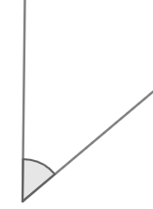
An angle is a measure of the amount of turn between two lines

Slide 8
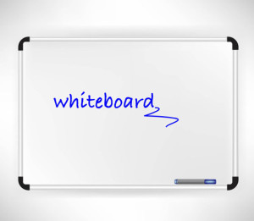
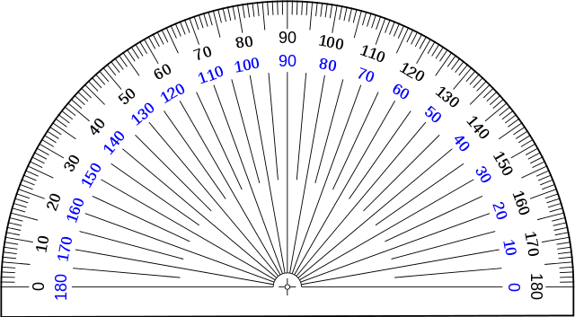
What is the size of the angle?
A
B
C
D
155$°$
145$°$
45$°$
35$°$

Slide 9
1)
What is the size of
this angle?
2) What is the size of this angle?
3) 360 $−$ 129 =

Slide 10
1)
What is the size of
this angle?
2) What is the size of this angle?
3) 360 $−$ 129 =
50$°$
135$°$
231

Slide 11
Core input
Notes:
If the last two questions were answered correctly students are asked to start the worksheets to confirm understanding.
Ensure they have self assessed effectively - they understand if they are struggling with worksheet they must come back to the input or it will be caught up later – TA to monitor independent learners.

Slide 12
Acute
Right
Obtuse
Half a turn

Slide 13
This is a protractor.
We can use it to measure the degrees of turn between two lines.

Slide 14
This the origin, we place this on the vertex where two lines meet.

Slide 15
35$°$
The baseline is placed on one of the lines

Slide 16
Outer scale
Inner scale
It is an acute angle
It is less than 90 degrees
The angle is 40 degrees
We can write this as 40$°$

Slide 17
The angle is 88$°$
It is an acute angle.

Slide 18
It is an obtuse angle.
The angle is 90$°$
It is a right angle.
It is greater than 90 degrees and less than 180 degrees
The angle is 140$°$

Slide 19
The angle is 180$°$
It is a straight line.

Slide 20
What is the size of the angle?
A
B
C
D
155$°$
145$°$
45$°$
35$°$

Slide 21
1)
What is the size of
this angle?
2) What is the size of this angle?
3) 360 $−$ 129 =

Slide 22
1)
What is the size of
this angle?
2) What is the size of this angle?
3) 360 $−$ 129 =
50$°$
135$°$
231

Slide 23
Extension
Notes:
Those who are just understanding first section work with TA to put into practice – those who branched off earlier back to undertake second part of lesson.

Slide 25
B
A
C
Which diagram or diagrams show the correct way to measure the angle?
B and C
What is the size of the angle?
124$°$

Slide 26
Neither of the lines is lined up with the protractor’s baseline, so we cannot find the size of this angle.
We don’t need to move the protractor – there’s a calculation we can perform!
90 $−$ 30 =
60$°$

Slide 27
161$°$
Describe how this protractor is being used incorrectly.
The origin of the protractor is not placed at
the vertex.

Slide 28
There are 360⁰
in a full turn.
143$°$
143$°$
360$°$
360 $−$ 143 =
217$°$
?

Slide 29
Write answers in books
Write answers on sheets
Can complete in choice order

Slide 30
1.

Slide 31
2.

Slide 32
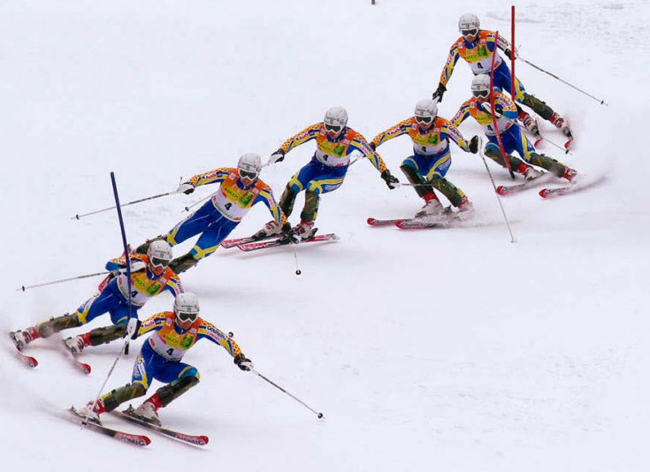
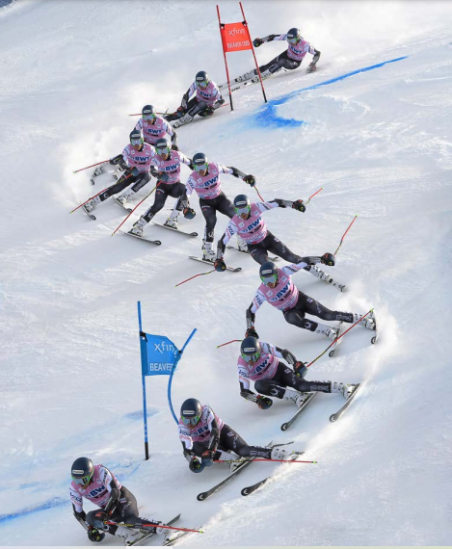
3.

Slide 33
4.

Slide 34
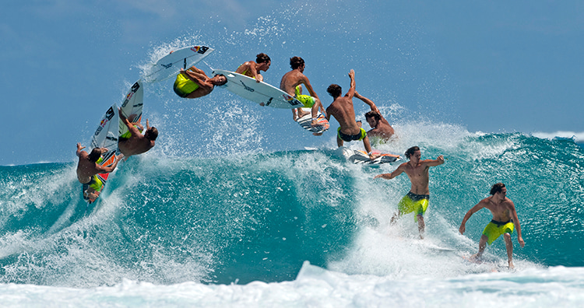
5.

Slide 35
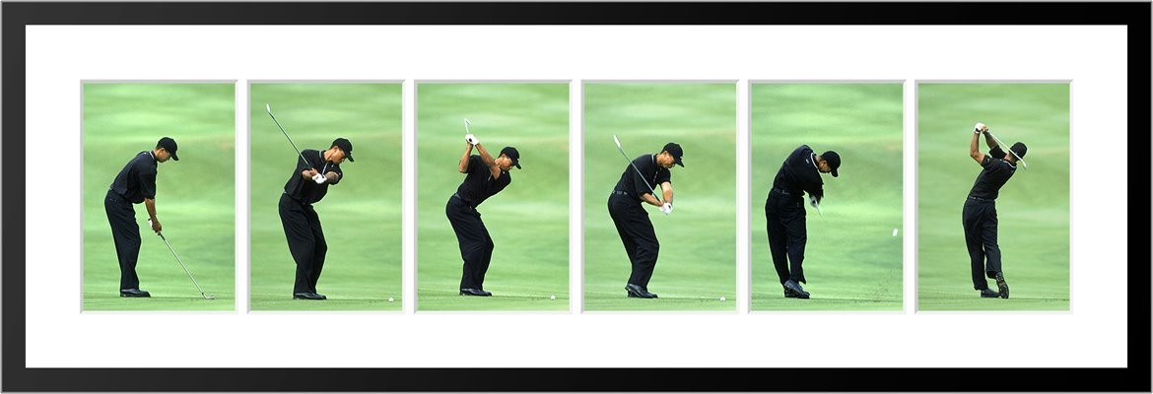
6.

Slide 36
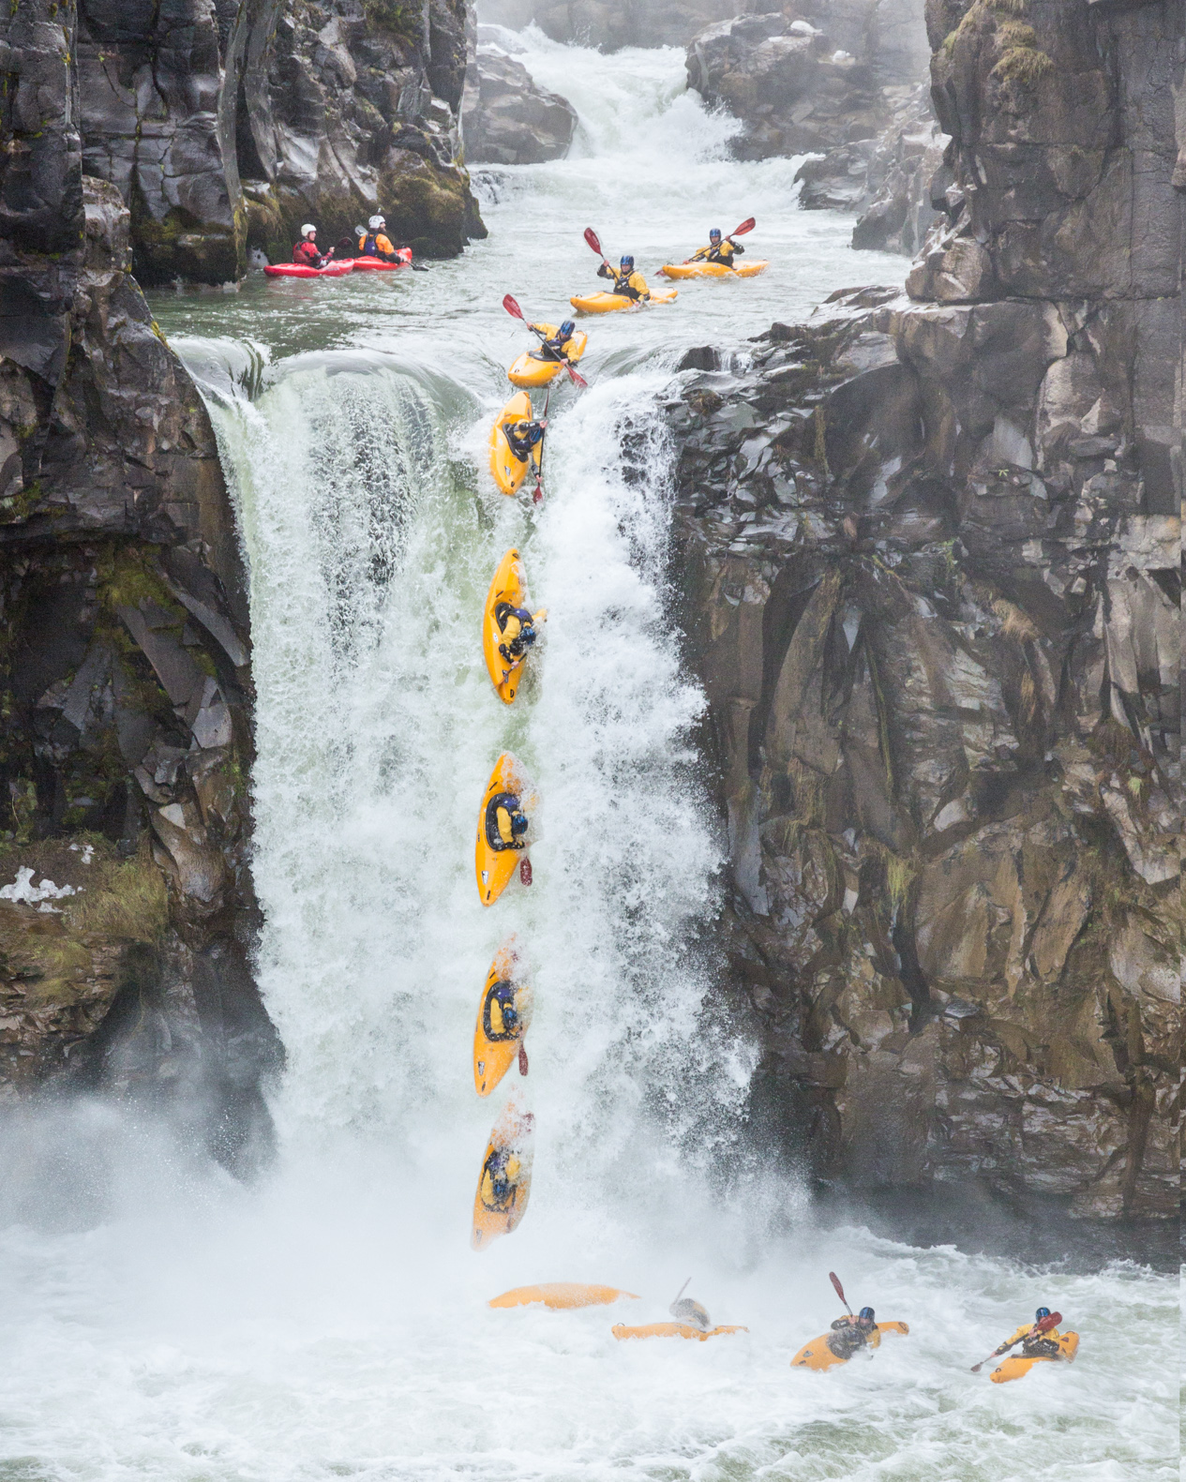
7.

Slide 37
Here are five angles. There are two pairs of identically sized angles and one odd one out.
Which angle is the odd one out?
Explain your reason.
c
a
b
d
e
Notes:
Angle e is the odd one out.
– if children are struggling as them to use a right angle checker – the corner of some paper to check each angle.
Angle b and c are both right angles.
Angle a and d are both half of a right angle or 45 degrees.
Angle e is an obtuse angle.

Slide 38
Always, sometimes or never true?
If I turn from North-East to North-West, I have turned 90˚
If I turn from East to North-West, I will have turned through an obtuse angle.
If I turn from South-West to South, my turn will be larger than 350˚
Notes:
All are sometimes true
Depending on whether you turn clockwise or anticlockwise or even more than one turn.

Slide 39
Always, Sometimes, Never.
W to S $=$ 90 degrees
NE to SW $=$ 180 degrees
E to SE in a clockwise direction $>$ 90°
Notes:
W to S = 90 degrees – Sometimes (dependent on direction of turn)
NE to SW = 180 degrees Always – regardless of turn direction)
E to SE in a clockwise direction > 90° Never (it is either 45 or 315 degrees)

Slide 40
If it takes 60 minutes for the minute hand to travel all the way around the clock, how many degrees does the minute hand travel in:
7 minutes
12 minutes
How many minutes have passed if the minute hand has moved 162°?
Notes:
To access the question – how many degrees per minute?
360 ÷ 60 = 6 so the minute hand travels 6° per minute.
7 minutes : 42° (7 x 6 = 42)
12 minutes : 72° (12 x 6 = 72)
162° : 27 minutes (162 / 6 = 27)

