Slide 2
Diving into Mastery Guidance for Educators
Each activity sheet is split into three sections, diving, deeper and deepest, which are represented by the following icons:
These carefully designed activities take your children through a learning journey, initially ensuring they are fluent with the key concept being taught; then applying this to a range of reasoning and problem-solving activities.
These sheets might not necessarily be used in a linear way. Some children might begin at the ‘Deeper’ section and in fact, others may ‘dive straight in’ to the ‘Deepest’ section if they have already mastered the skill and are applying this to show their depth of understanding.
Diving
Deeper
Deepest

Slide 3
Aim
Read and write numbers up to 1000 in numerals and in words.

Slide 4
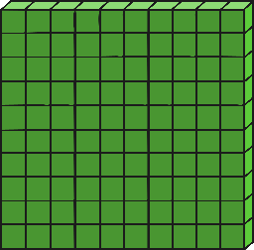
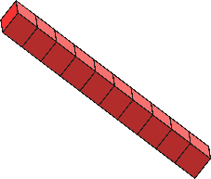
100s, 10s and 1s (1)
Diving
How would we write the number 674 in words?
six hundred and seventy-four
How would we show the number two hundred and eighty-one using base ten blocks?
What number is shown by these base ten blocks?
Answer
414

Slide 5
100s, 10s and 1s (1)
Deeper
Look at these digit cards:
4
2
1
8
5
9
What is the smallest 3-digit number you could use these cards to make?
What is the greatest 3-digit
number you could make?
124
985

Slide 6
100s, 10s and 1s (1)
Deeper
What is the value of each digit in this number?:
532
500
(or 5 hundreds)
30
(or 3 tens)
2
(or 2 ones)

Slide 7
100s, 10s and 1s (1)
Deepest
I’m thinking of a 3-digit number that I can make using these digit cards. I can only use each card once.
3
2
1
8
4
0
There are no tens.
The hundreds digit is a greater number than the ones digit.
The digit total (the digits added together) is 7.
What number am I thinking of?
403

Slide 8
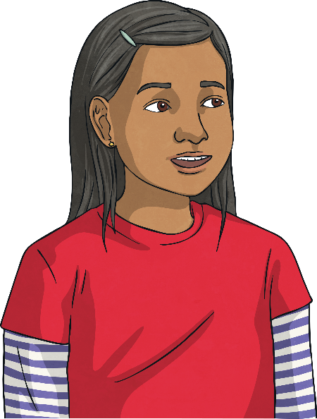
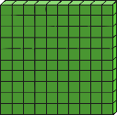
100s, 10s and 1s (1)
Deepest
Carina isn’t sure how to use base ten to represent 671.
She has tried a few different ideas.
Which one is correct?

Slide 9
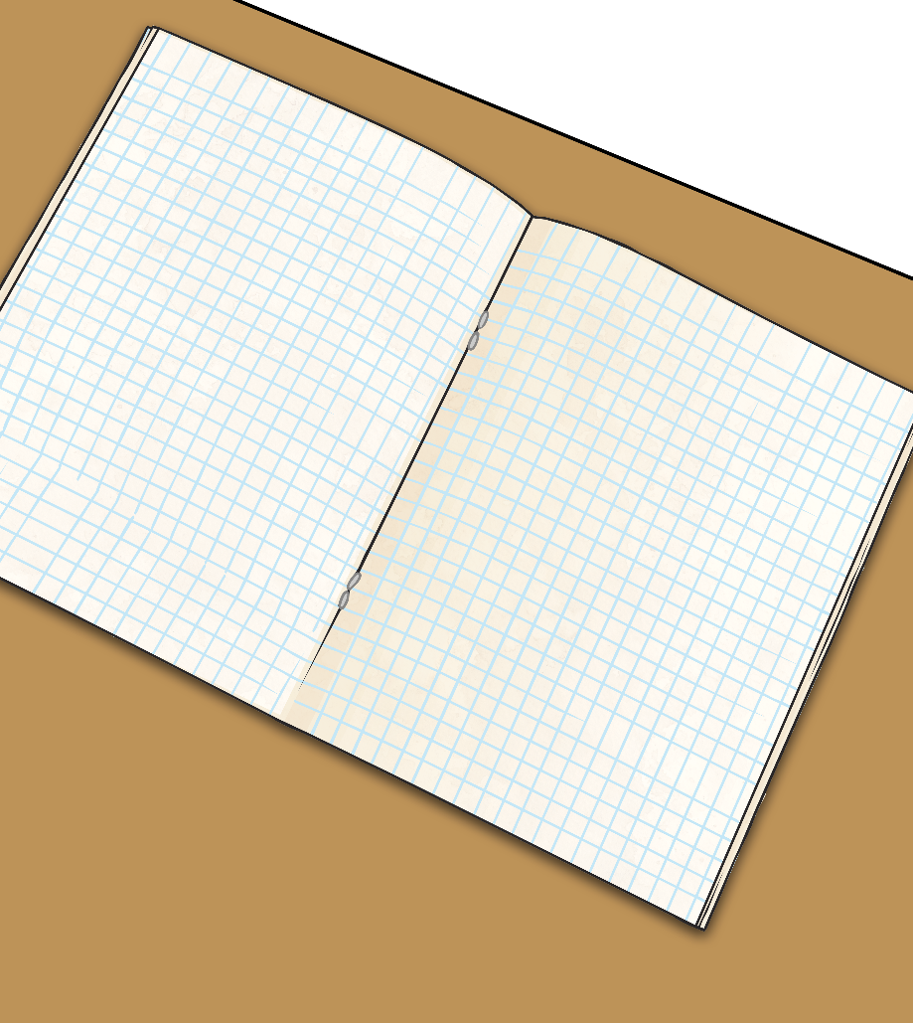
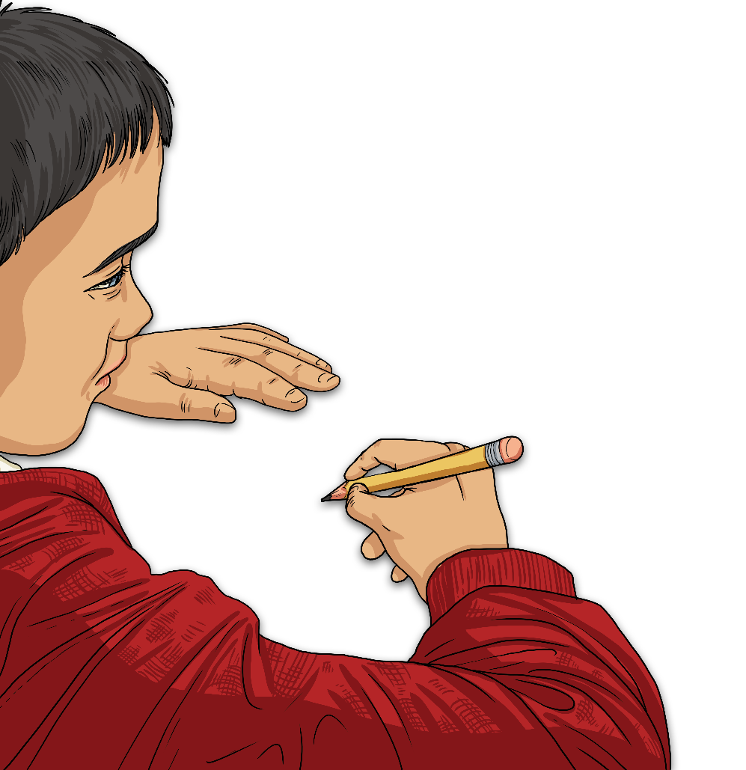
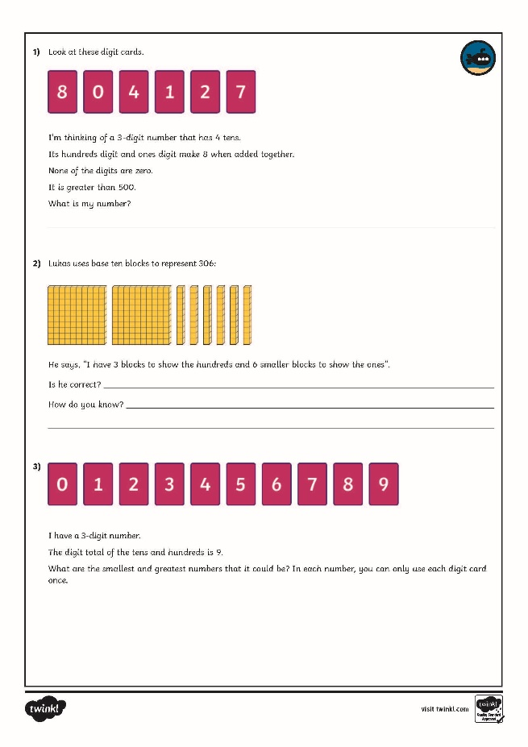
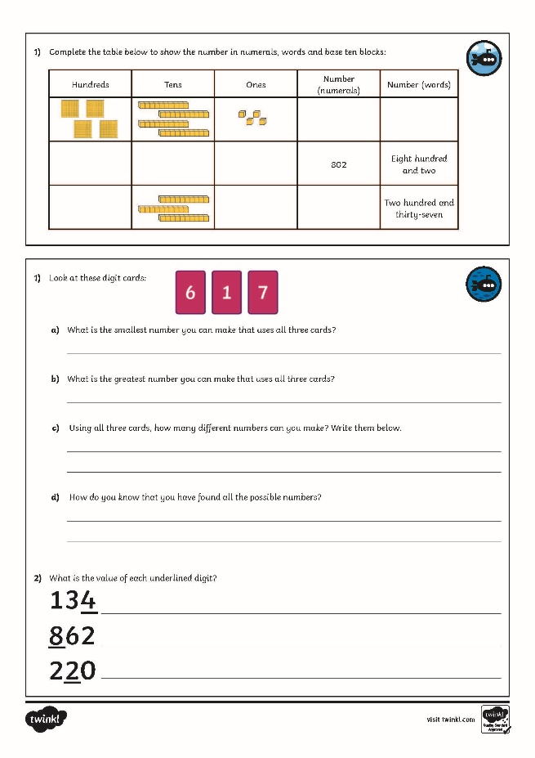
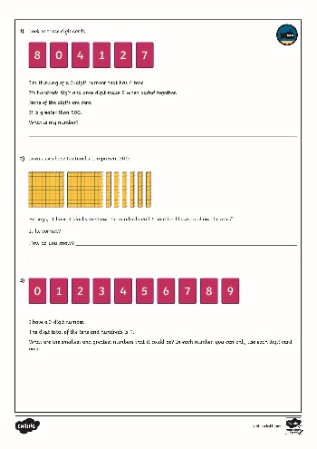
100s, 10s and 1s (1)
Dive in by completing your own activity!

Slide 10
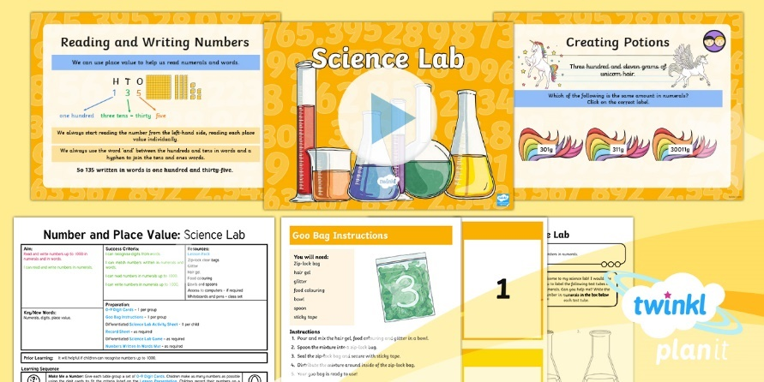
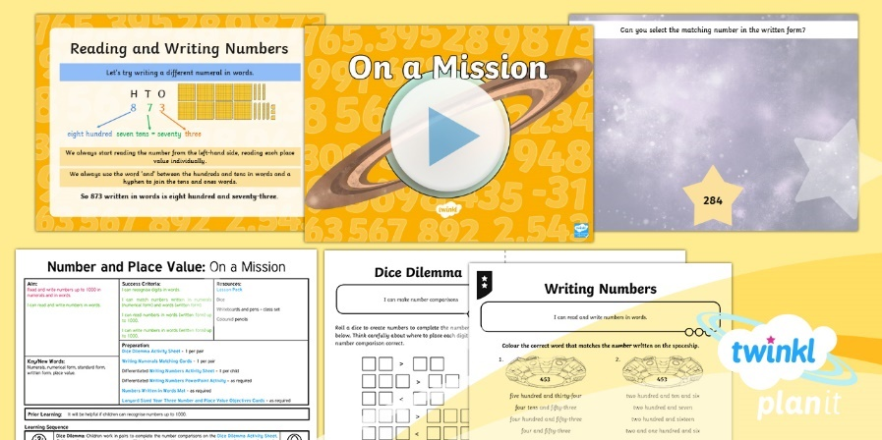
Need Planning to Complement this Resource?
National Curriculum Aim
Read and write numbers up to 1000 in numerals and in words.
For more planning resources to support this aim, click here.
Twinkl PlanIt is our award-winning scheme of work with over 4000 resources.

